Slide 1
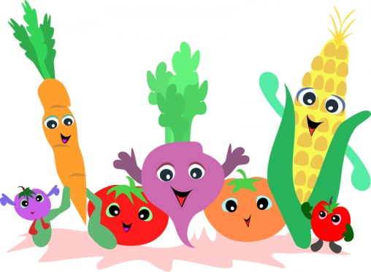
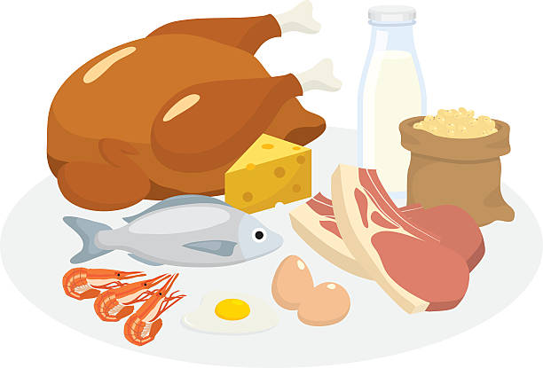
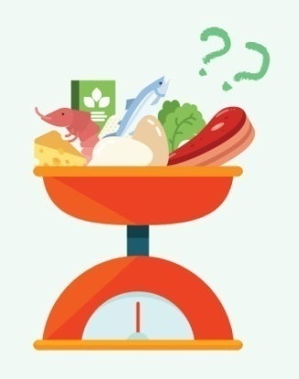
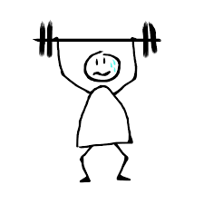
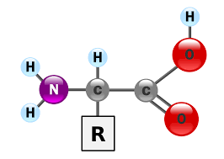
Addiction to high protein diet
Presentation by Colegiul Tehnic “Lațcu Vodă” team

Slide 2
The importance of protein in nutrition and health cannot be overemphasized. It is quite appropriate that the Greek word chosen as a name for this nutrient is “proteios”, meaning “primary” or “taking first place.”

Slide 3
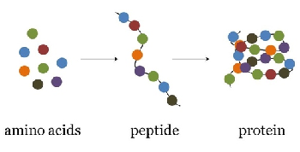
Proteins are found throughout the body, with over 40% of body protein found in skeletal muscle, over 25% found in body organs, and the rest found mostly in the skin and blood.
Proteins are essential nutritionally because of their constituent amino acids, which the body must have in order to synthesize its own variety of proteins and nitrogen-containing molecules that make life possible. Each body protein is unique in the characteristics and sequence pattern of the amino acids that comprise its structure.

Slide 4
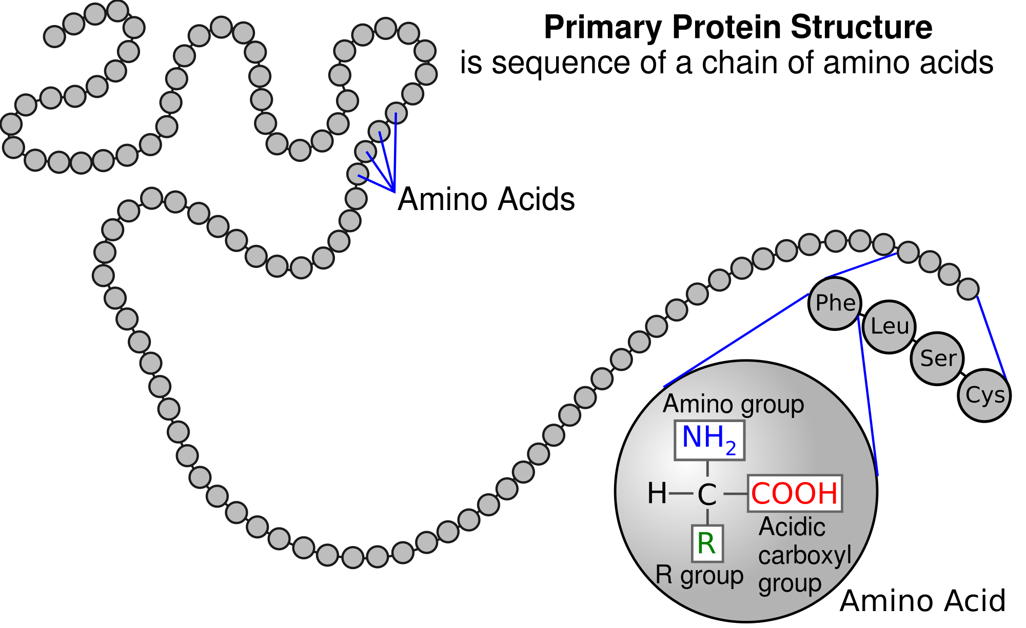

Slide 5
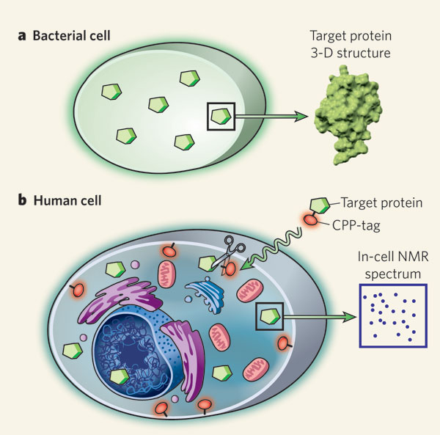
The molecular architecture and activity of living cells depend largely on proteins, which make up over half of the solid content of cells and which show great variability in size, shape, and physical properties. Their physiological roles are also quite variable.
Functional Categories

Slide 6
1. CATALYSTS
Enzymes are protein molecules (generally designated by the suffix -ase) that act as catalysts: they change the rate of reactions occurring in the body. Enzymes are found both intracellularly and extracellularly, such as in the blood.

Slide 7
2. MESSENGERS
Some proteins are hormones. Hormones act as chemical messengers. They are synthesized and secreted by endocrine tissue (glands) and transported in the blood to target tissues or organs, where they bind to protein receptors. Hormones generally regulate metabolic processes.

Slide 8
3. STRUCTURAL ELEMENTS
Several proteins have structural roles in the body. Some of these proteins include: - contractile proteins -actin and myosin, are found in cardiac, skeletal, and smooth muscles - fibrous proteins - include collagen, elastin, and keratin and are found in bone, teeth, skin, tendons, cartilage, blood vessels, hair, and nails - globular proteins - include myoglobin, calmodulin, and many enzymes.

Slide 9
4. IMMUNOPROTECTORS
Immunoprotection is provided to the body in part by a group of proteins called immunoproteins, also called immunoglobulins (Ig) or antibodies (Ab)

Slide 10
5.TRANSPORTERS
Transport proteins are a diverse group of proteins that combine with other substances (especially vitamins and minerals, but also other nutrients) to provide a means of carrying those substances in the blood, or into cells, or out of cells, or within cells.
Eg: - hemoglobin, found in red blood cells, transports oxygen and carbon dioxide - albumin transports a variety of nutrients such as calcium, zinc and vitamin B6 - transferrin is an iron transport protein - lipoproteins transport lipids in the blood

Slide 11
6. BUFFERS
A buffer is a compound that helps to regulate acid-base balance.

Slide 12
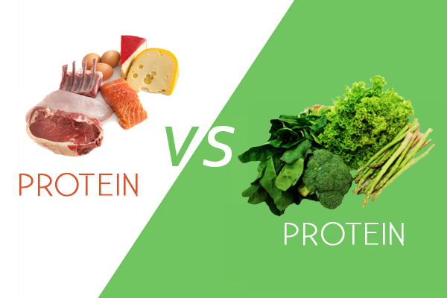

Slide 13
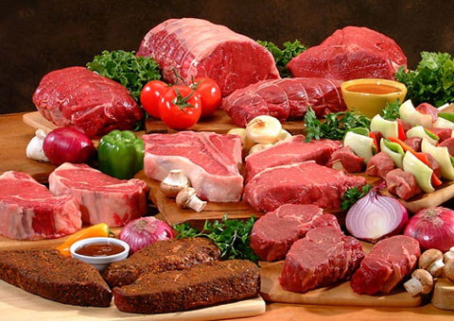
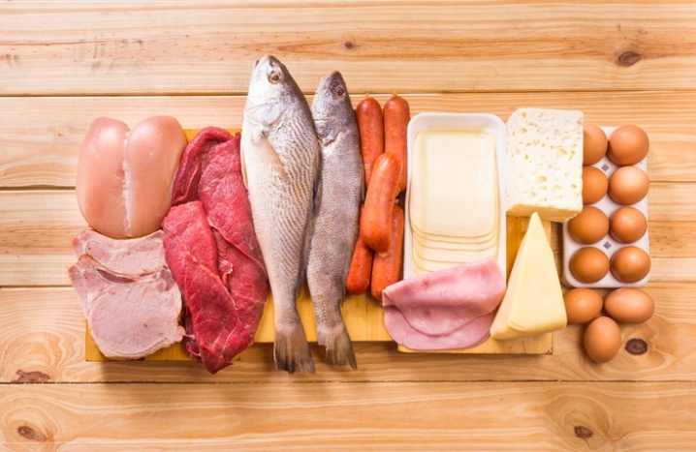
Sources of Protein
Dietary or exogenous sources of protein include: * animal products such as meat, poultry, fish, and dairy products (with the exception of butter, sour cream, and cream cheese)

Slide 14
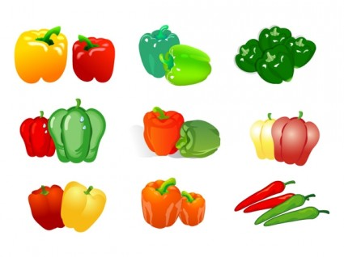
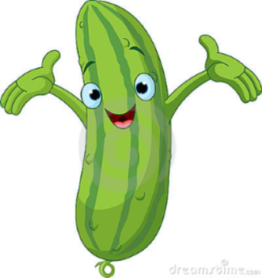
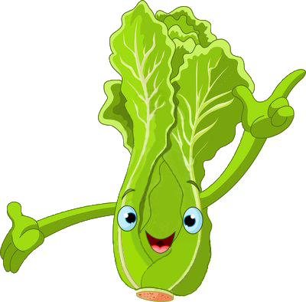
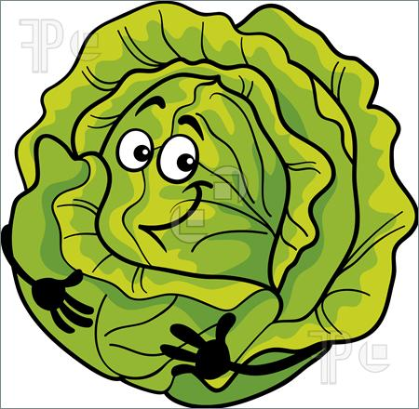
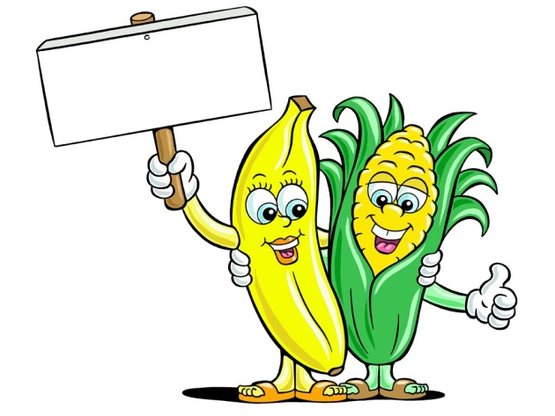
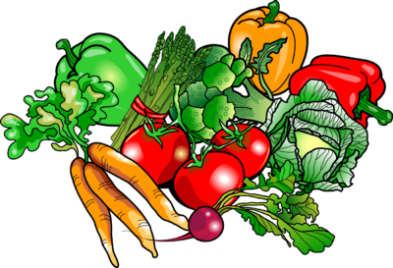
*plant products such as grains, grain products, legumes, and vegetables

Slide 15
Good sources of protein
Food (1 ounce ≈ 28 grams) | Protein (grams)
3 ounces tuna, salmon, haddock, or trout | 21
3 ounces cooked turkey or chicken | 19
6 ounces plain Greek yogurt | 17
½ cup cottage cheese | 14
½ cup cooked beans | 8
1 cup of milk | 8
1 cup cooked pasta | 8
¼ cup or 1 ounce of nuts (all types) | 7
1 egg | 6

Slide 16
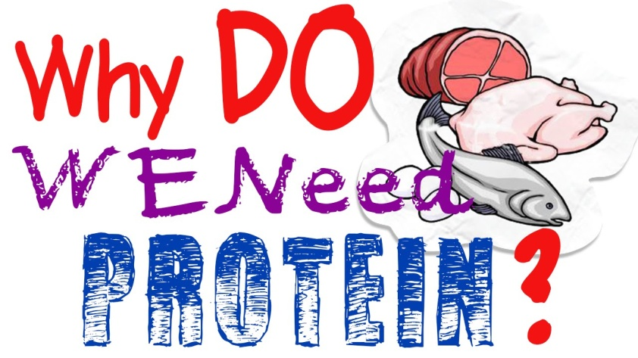
Protein Quality and Protein Intake Dietary protein is required by humans because it contributes to the body’s supply of indispensable amino acids and to its supply of nitrogen for the synthesis of the dispensable amino acids.

Slide 17
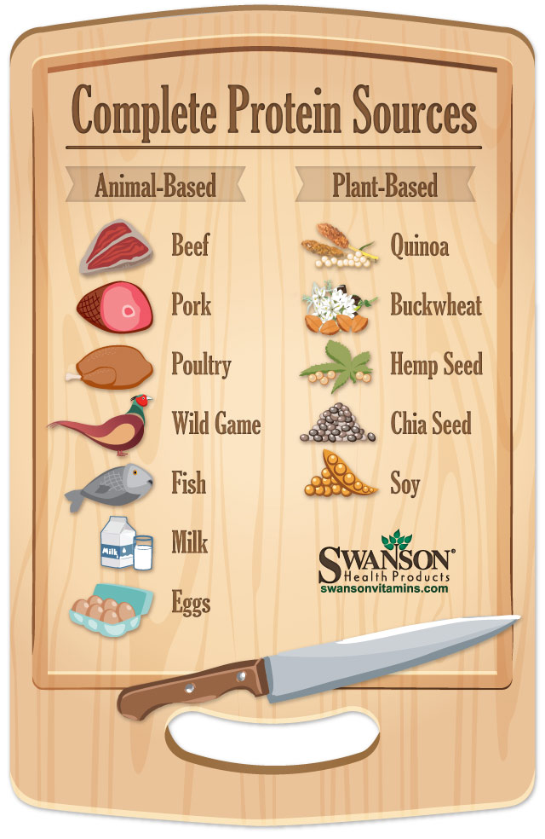
Protein-containing foods can be divided into two categories:
1. High-quality or complete proteins - contains all the indispensable amino acids in the approximate amounts needed by humans; sources of complete proteins are mostly foods of animal origin such as milk, yogurt, cheese, eggs, meat, fish, and poultry.

Slide 18
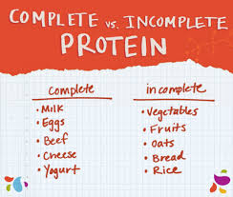
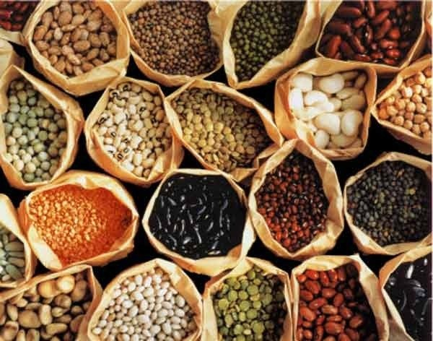
2. Incomplete proteins or low-quality proteins are derived from plant foods such as legumes, vegetables, cereals, and grain products; so they have too little of one or more particular indispensable amino acids.

Slide 19
Digestibility of proteins is also important for amino acid use. Meat and cheese, for example, have a digestibility of 95%, and eggs are 97% digestible. Cooked split peas are about 70% digestible, and tofu is about 90% digestible. Both the digestibility of a protein and its amino acid content affect protein quality. A well-balanced diet should contain 50–60% of the calorie intake as carbohydrate, no more than 35% as fats and approximately 15% as protein. In addition, there should be sufficient amounts of fibre, vitamins and minerals.

Slide 21
RECOMMENDED PROTEIN AND AMINO ACID INTAKES Protein and amino acid requirements of humans are influenced by age, body size, and physiological state, as well as by the level of energy intake. The estimated average requirement for protein for adults (men and women age 19 years and older) was 0.7 g protein per kg body weight per day. This value represents the lowest continuing dietary protein intake necessary to an adult. The recommended dietary allowance (RDA) for protein for adults is 0.8 g protein per kg body weight per day - 15% (between 10% and 18%) of total energy (kcal).

Slide 22
WHO recommendations on protein intake in children and adolescents
Age g/kg g/day Age g/kg g/day
3-6 mths 1,85 13 Girls
6-9 mths 1,65 14 10-12 years 1,00 36
9-12 mths 1,50 14 12-14 years 0,95 44
1-2 years 1,20 13,5 14-16 years 0,9 46
2-3 years 1,15 15,5 16-18 years 0,8 42
3-5 years 1,10 17,5 Boys
5-7 years 1,00 21 10-12 years 1,00 34
7-10 years 1,00 27 12-14 years 1,00 43
14-16 years 0,95 52 16-18 years 0,9 56
Infants and children
Adolescents

Slide 23
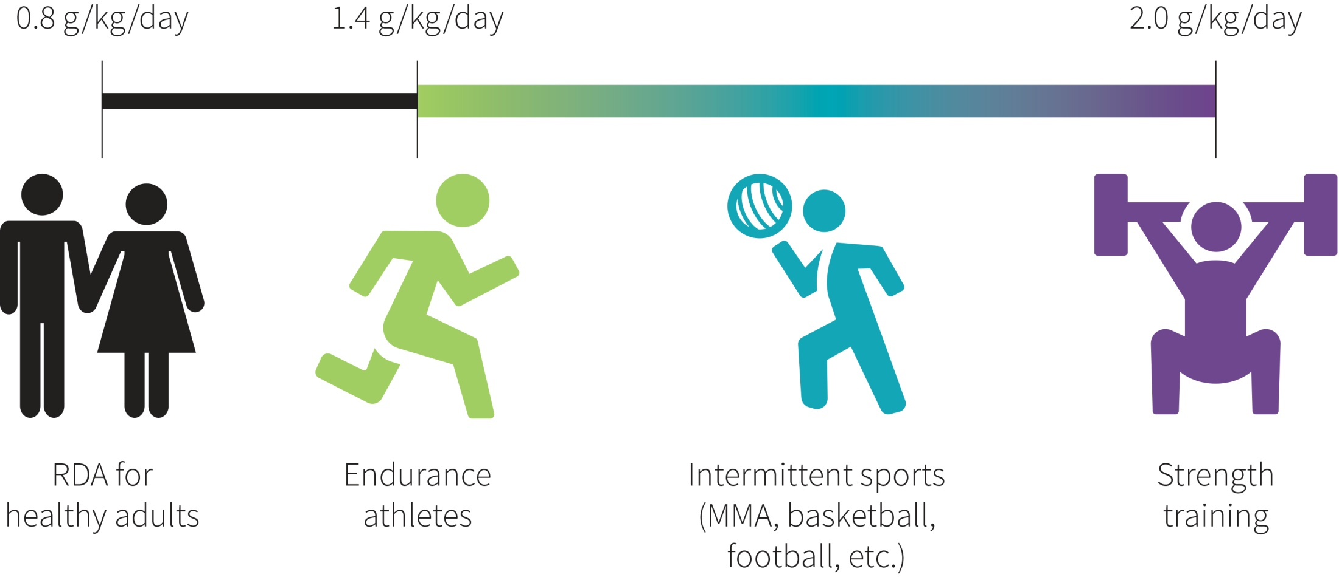

Slide 24
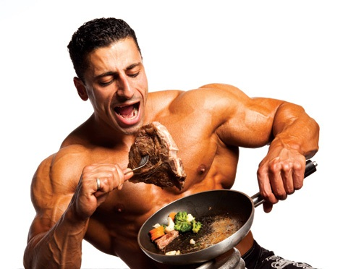
The metabolic needs of endurance athletes (long distance runners, distance swimmers and cyclists) are different from those for people undertaking intermittent activity (football, hockey, cricket and golf) and sports of short but intense duration, e.g. sprinters and wing three-quarters in rugby. Bodybuilding sportsmen such as weight-lifters have yet different needs.

Slide 25
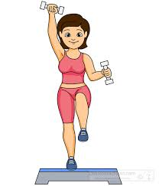
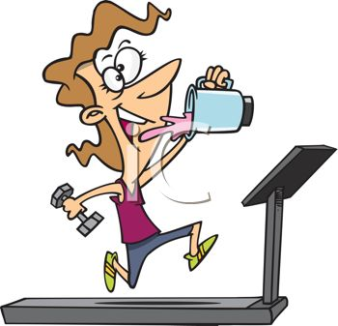
Do athletes require more protein? Endurance athletes in heavy training require extra protein to cover a small proportion of the energy costs of their training and to assist in the repair and recovery process after exercise. Strength athletes, who are interested in gaining muscle size and function, require more protein in the early stages of very intensive resistance exercise.

Slide 26
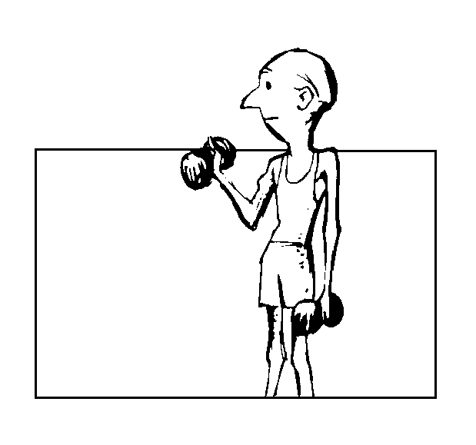
However, strength athlete’s muscles seem to adapt to the stress of resistance exercise, so that the protein requirements to maintain protein balance in very well-trained athletes are only marginally greater than those of generally active people. Athletes, who are growing, such as adolescents, have additional protein requirements.

Slide 27
Estimated protein requirements for athletes
Group | Protein intake (g/kg/day)
Sedentary men and women | 0.8 - 1.0
Elite male endurance athletes | 1.6
Moderate-intensity endurance athletes (exercising approximately four to five times per week for 45-60 min) | 1.2
Recreational endurance athletes (exercising four to five times per week for 30 min ) | 0.8 - 1.0
Football, power sports | 1.4 - 1.7
Resistance athletes (early training) | 1.5 - 1.7
Resistance athletes (steady state) | 1.0 - 1.2
Female athletes | ~15% lower than male athletes

Slide 28
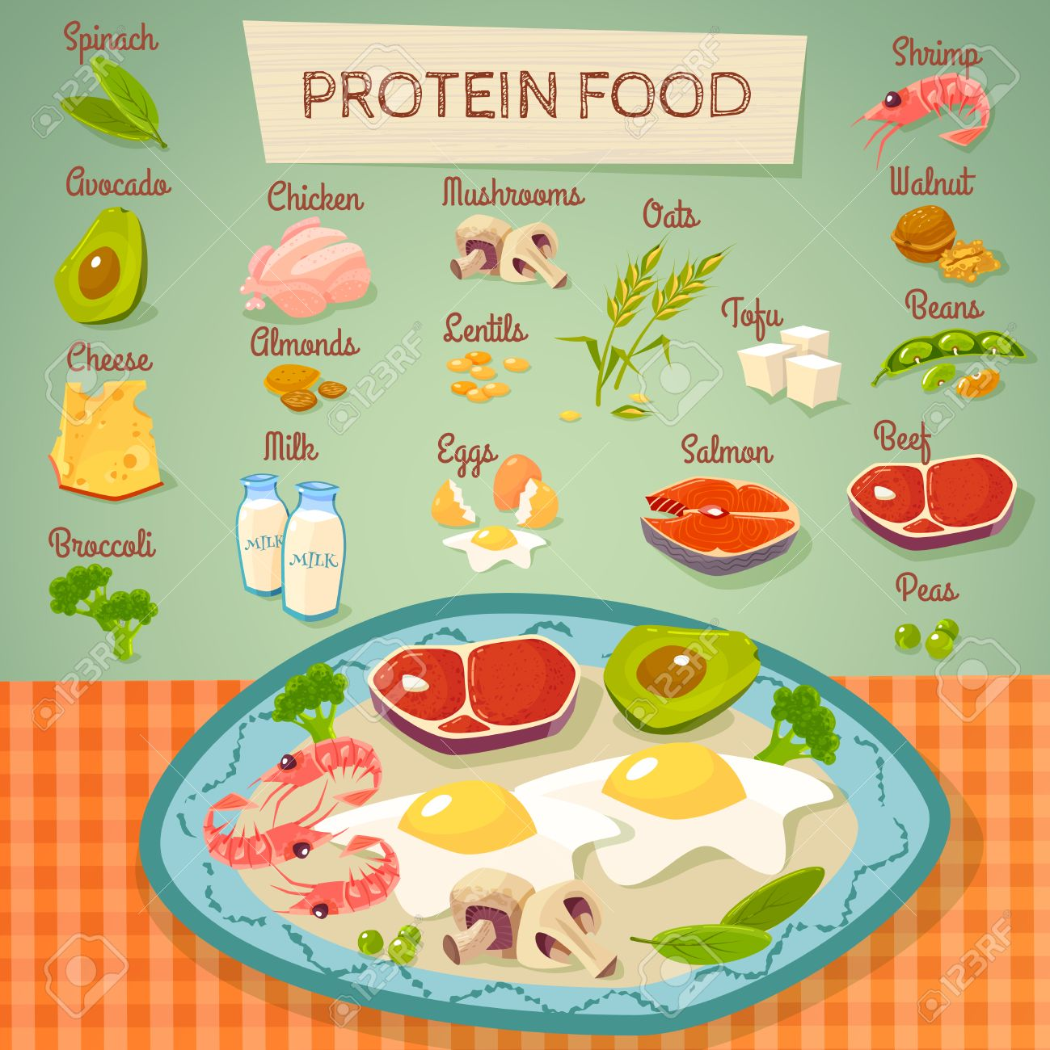
Do athletes need to eat more protein-rich foods? Generally, athletes enjoy the advantage of increased energy requirements that make it possible to consume even larger amounts of protein and other nutrients than the sedentary person. Numerous dietary surveys show that the dietary patterns reported by various groups of athletes provide protein intakes that are well in excess of 2.0 g/kg body mass per day - especially in the case of strength-training athletes. Therefore, there is little scientific justification for special high protein eating strategies for sport.

Slide 29
How does timing and teamwork of protein and other nutrients work? Recovery after each workout or competition is a challenge for the athlete. Recovery processes are complex and include refueling, rehydrating and repairing. Muscle and body protein metabolism is a constant balance between protein breakdown and protein rebuilding. During exercise the balance shifts towards protein breakdown, while during the recovery period after exercise the balance tips in the opposite direction.

Slide 30
By consuming protein immediately after exercise it enhances muscle uptake and retention of amino acids, and promotes a more positive protein balance. This heightened state of protein metabolism seems to last for up to 24 hours and it is important for athletes to look at their protein spread throughout the rest of the day as well as immediately after exercise.

Slide 31
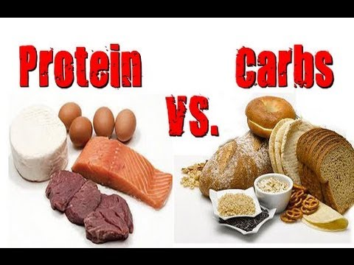
The most important news is that the effect of post-exercise protein intake is best seen when the protein is combined with carbohydrate. Carbohydrate intake stimulates an increase in the hormone insulin, which in turn, stimulates the muscle to take up the amino acids. A protein-carbohydrate snack or meal after a workout makes good sense - not only for muscle repair and adaptation to training, but to provide carbohydrate fuel to restore muscle glycogen levels.

Slide 32
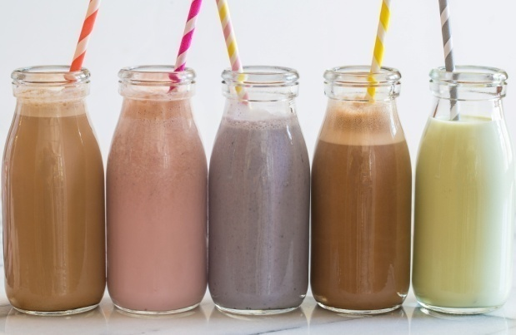
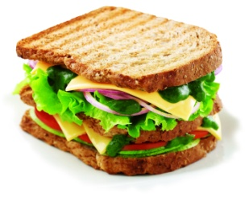
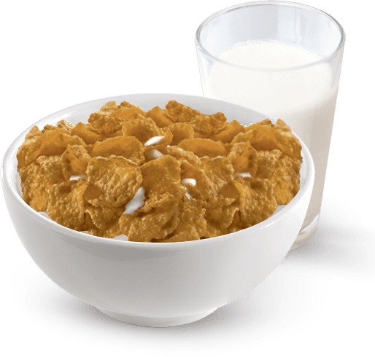
Snacks or light meals that achieve this team-work include:
Flavoured yoghurt
Flavoured milk drinks
Fruit smoothies
Sandwiches with meat, cheese, chicken or peanut butter fillings
Breakfast cereal and milk

Slide 33
Can athletes have too much protein? Daily protein intakes under 2 g/kg BM in healthy people are unlikely to cause side effects. Less is known about the long-term side effects of protein intakes above 2 g/kg BM. High protein intakes can increase the amount of calcium excreted in the urine. This may cause problems with athletes at risk of weakened bones - for example, female athletes with low energy intakes who are not menstruating.

Slide 34
High protein intakes are also known to accelerate the progression of pre-existing kidney disease. From a nutritional point of view, excessive intakes of protein tend to be expensive especially if protein supplements are used. High protein intakes based on the consumption of large amounts of animal foods (e.g. meat and dairy foods) can result in a greater fat intake. High protein intakes may increase fluid requirements. However, the main concern is that excessive focus on high protein foods may displace other valuable foods (e.g. fruit and vegetables) or other important nutrients such as carbohydrate and fibre from the diet.

Slide 35
Dehydration, caused by the need to excrete large amounts of urea and other nitrogenous wastes from protein catabolism, can be prevented with appropriate fluid consumption. Effects on bone vary; studies suggest catabolic effects. The catabolic effects of a high protein diet on bone are most commonly attributed to the generation of large amounts of acids from the dietary protein, such as increased osteoclast activity which releases calcium, magnesium, and carbonate. This can cause osteoporosis.

Slide 36
Adverse Effects Associated with Protein Intake above the Recommended Dietary 1. Disorders of Bone and Calcium Homeostasis Diet which is high in protein generates a large amount of acid in body fluids. The kidneys respond to this dietary acid challenge with net acid excretion, and, concurrently, the skeleton supplies buffer by active resorption of bone resulting in excessive calcium loss. Virtually osteoclast cells that break down bone and release calcium are activated. This increases the risk of osteoporosis and reduces renal calcium reabsorption (hypercalciuria).

Slide 37
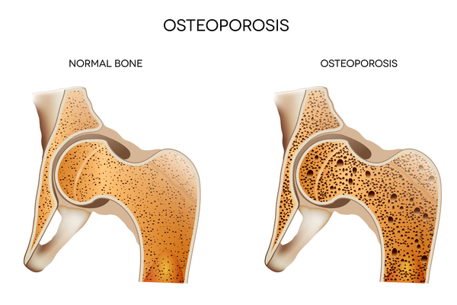
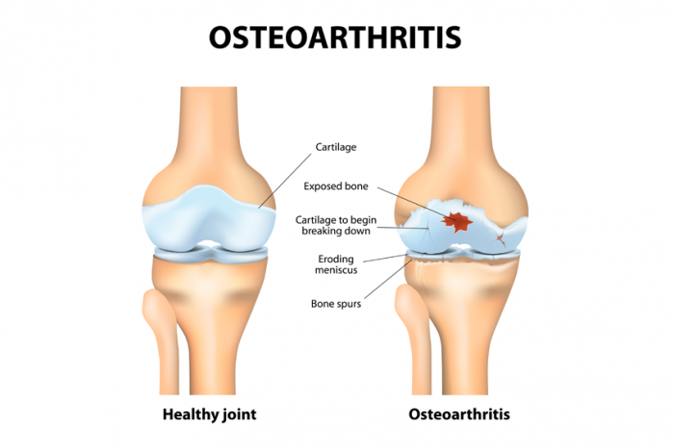

Slide 38
2. Disorders of Renal Function Low fluid intake and excessive intake of protein are important risk factors for kidney stones. Protein ingestion increases renal acid excretion, and acid loads, in turn, may be buffered in part by bone, which releases calcium to be excreted by the kidney. This protein-induced hypercalciuria could lead to the formation of calcium kidney stones. Furthermore, animal protein is also the major dietary source of purines, the precursors of uric acid. Excessive intake of animal protein is therefore associated with hyperuricosuria, a condition present in some uric acid stone formers.

Slide 39
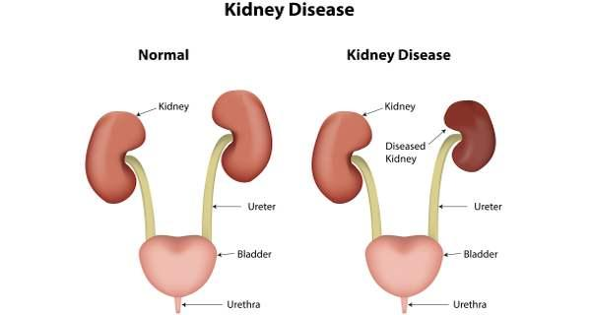

Slide 40
3. Increased Cancer Risk, Disorders of Liver Function, and Precipitated Progression of Coronary Artery Disease Up to 80% of breast, bowel, and prostate cancers are attributed to dietary practices, and international comparisons show positive associations with high meat diet. The association, however, seems to have been more consistently found for red meat or processed meat and colorectal cancer. It should be noticed that red meat is the main dietary source of saturated fat, which has been associated with breast and colorectal cancers.

Slide 41
Are protein supplements useful? Generally, athletes can obtain all the protein they require from a good mixed diet. Occasionally, an athlete may require a supplement when a practical way to consume sufficient food cannot be found. Many protein supplements are very expensive due primarily to the amount of marketing that accompanies products and the processing required to extract the protein from cow’s milk. They tend to provide very large amounts of protein and little other nutrients. There is no need for the amount of protein provided by many supplements and there is certainly no justification for the extra cost.

Slide 42
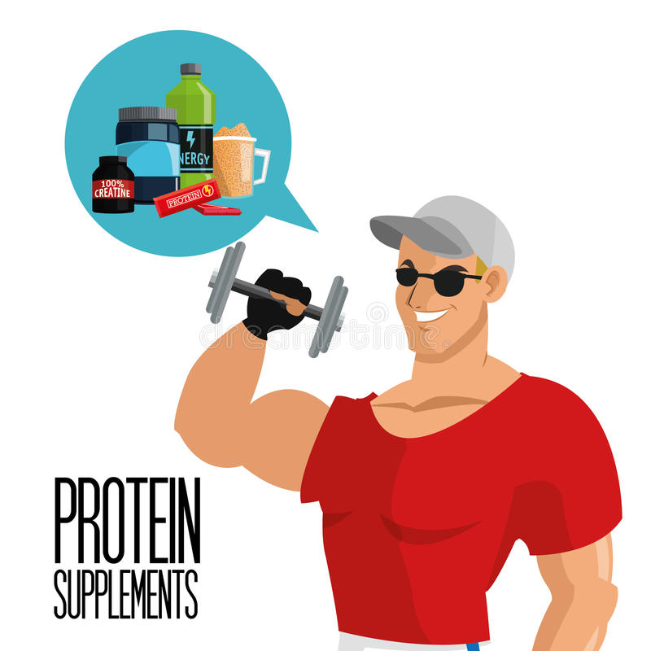
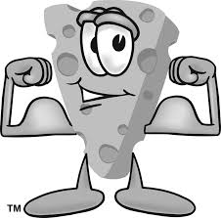
The most suitable supplement is one that provides both protein and carbohydrate. Good alternatives to protein supplements include homemade fruit smoothies, liquid meal supplements such as PowerBar Protein Plus powder and 20 g skim milk powder added to regular milk.

Slide 43
Despite the fact that short-term high protein diet could be necessary in several pathological conditions (malnutrition, sarcopenia, etc.), it is evident that “too much of a good thing” in diet could be useless or even harmful for healthy individuals. Many adults or even adolescents (especially athletes or body builders) self-prescribe protein supplements and overlook the risks of using them, mainly due to misguided beliefs in their performance-enhancing abilities. Individuals who follow these diets are therefore at risk.

Slide 44
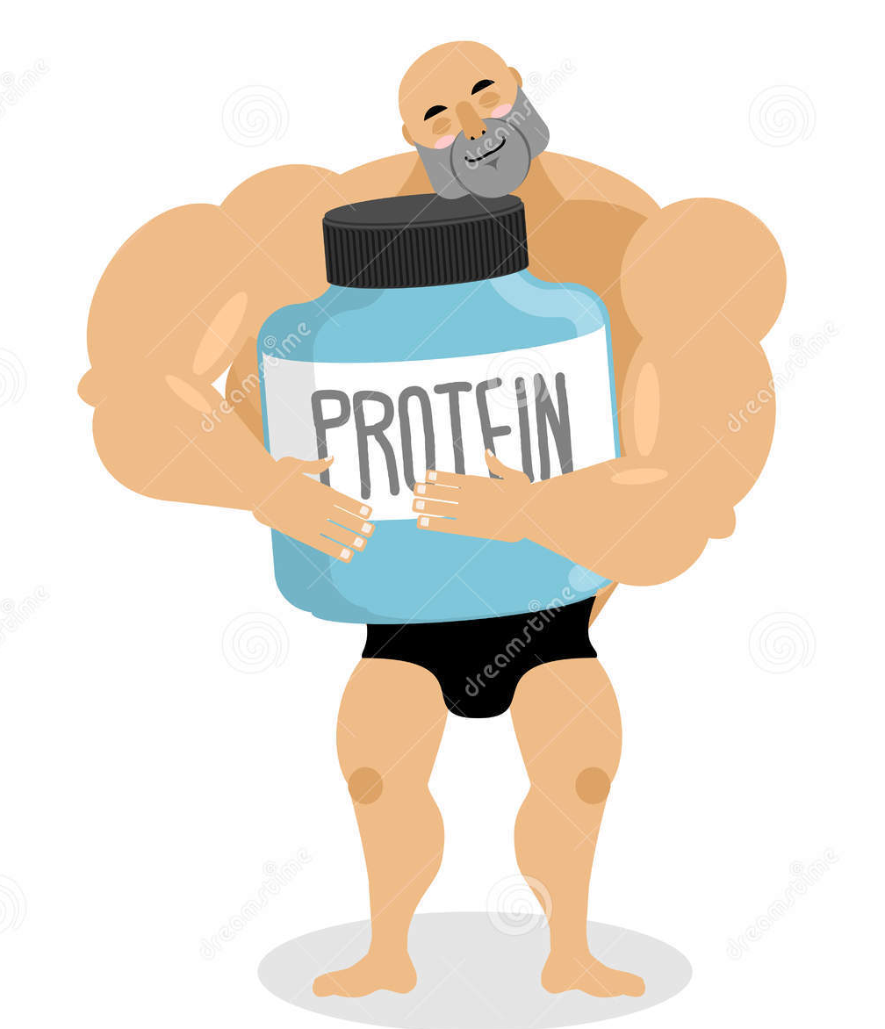
Extra protein is not used efficiently by the body and may impose a metabolic burden on the bones, kidneys, and liver. Moreover, high-protein/ high-meat diets may also be associated with increased risk for coronary heart disease due to intakes of saturated fat and cholesterol or even cancer.

Slide 45
Guidelines for diet should adhere closely to what has been clinically proved, and by this standard there is currently no basis to recommend high protein/high meat intake above the recommended dietary allowance for healthy adults.
This is the conclusion of a review published by US National Library of Medicine National Institutes of Health following the analysis of 32 studies (21 experimental human studies and 11 reviews).

Slide 46
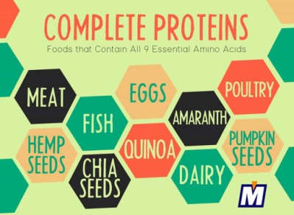
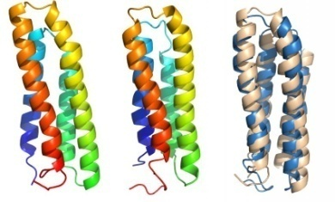
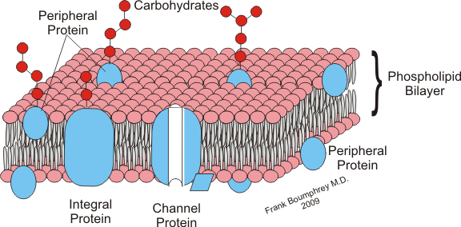
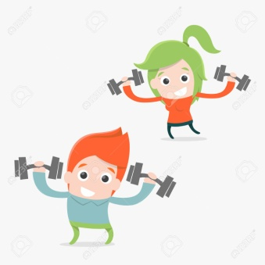
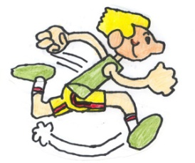
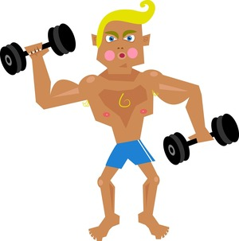
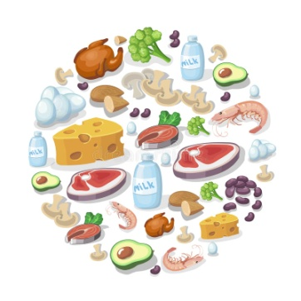
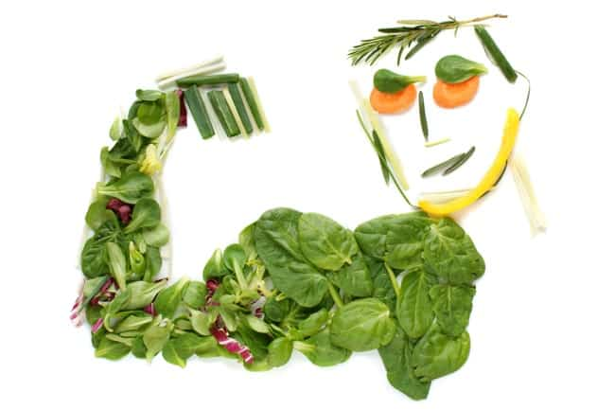
Thank you for your attention
!!!
We hope that you learned something useful from our presentation.

Slide 47
