Slide 1
ERASMUS+ KA2 MOVING2HEALTH
DEVELOPING EMOTIONAL HEALTH AND WELL BEING

Slide 2
Mental and emotional well-being is essential
to overall health
Positive mental health allows people to realize their full potential, cope with the stresses of life, work productively, and make meaningful contributions to their communities.

Slide 3
Early childhood experiences have lasting, measurable consequences later in life;
Therefore, fostering emotional well-being from the earliest stages of life helps build a foundation for overall health and well-being.

Slide 4
Emotionally healthy people are those who can control their emotions and behaviour, who show resilience in troubling situations and can build strong, lasting relationships.
It is also important to note that like any desired state emotional health requires dedication and effort.
A healthy emotional state doesn’t just happen

Slide 5
When considering wellness, people tend to think of physical activity or nutrition first but your emotional well-being is a crucial part of your overall health.
Feelings are hard for some people to express and talk about.
Being aware of what you are feeling can help you to channel your emotions into productive, positive feelings.
Achieving emotional balance lays the foundation for total body well-being.
Here are some ways to maintain your emotional dimension of wellness.”

Slide 6
YOGA
Yoga is a group of physical, mental, and spiritual practices or disciplines which originated in ancient India.
There is a broad variety of yoga schools, practices, and goals in Hinduism, Buddhism, andJainism
Among the most well-known types of yoga are Hatha yoga , Rāja yoga ,Sadhana Yoga

Slide 7
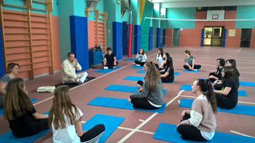
YOGA
Yoga gurus from India later introduced yoga to the West
n the 1980s, yoga became popular as a system of physical exercise across the Western world.
Yoga in Indian traditions, however, is more than physical exercise; it has a meditative and spiritual core.

Slide 8
BIODANCE
Biodance (neologism from the Greek bio (life) and the Spanish danza (dance), literally the dance of life) is a system of self-development that uses music, movement and positive feelings to deepen self-awareness.
It seeks to promote the ability to make a holistic link to oneself and one's emotions and to express them.
Biodance also claims to allow to deepen the bonds with others and nature and to express those feelings congenially .

Slide 9
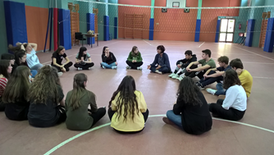
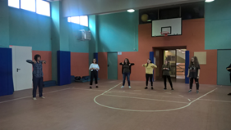
BIODANCE
Biodance claims to be a "human integration system of organic renewal, of affective re-education, and of relearning of Life's original functions. Its application consists in dancing, singing, making movements and group encounter situations".
It is a method which aims at the development of human capacities, including the feeling of happiness, communication skills and improving relationships

Slide 10
Thanks for your attention
Erasmus+KA2
Moving 2 Health

