Slide 1
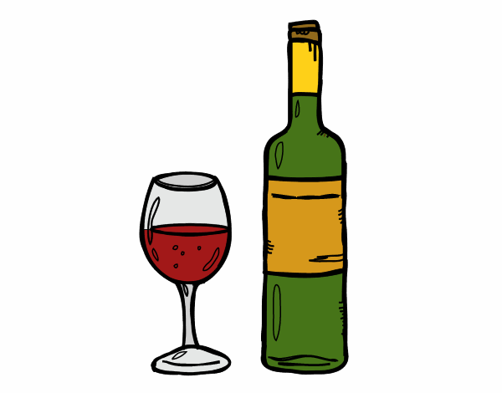
French eating habits
By BASSON Agatha & DIOT Juliette

Slide 2
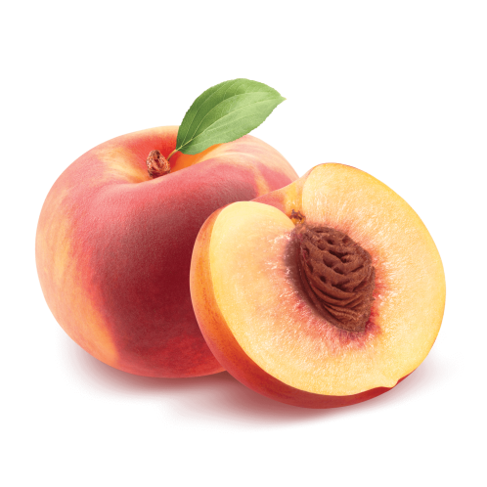
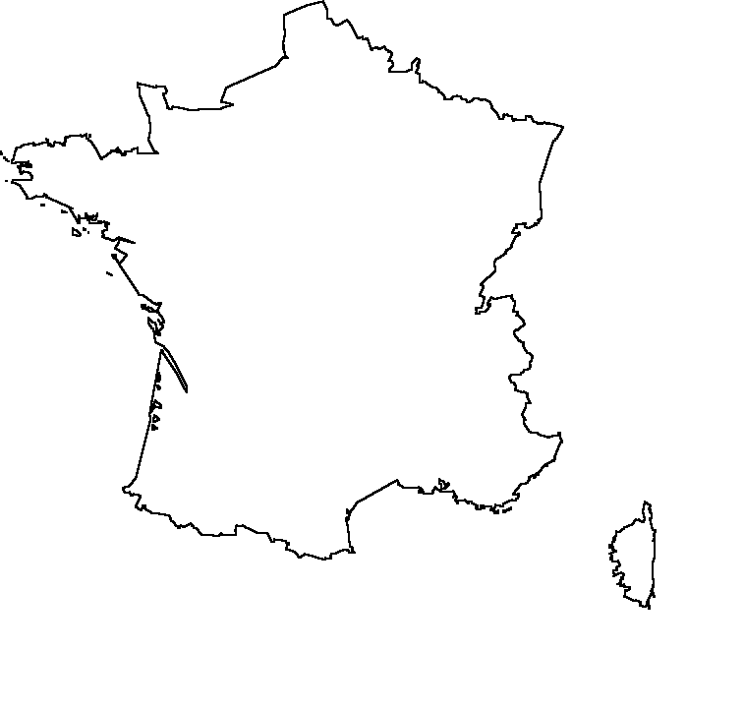
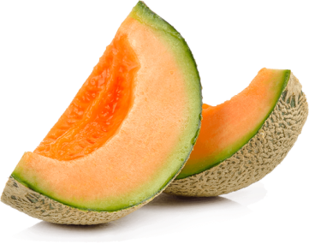
I. Likes and dislikes
Favorite french’s fruit
Values per person per year
People eat 3 to 4 fruits/day
Favorite in regions

Slide 3
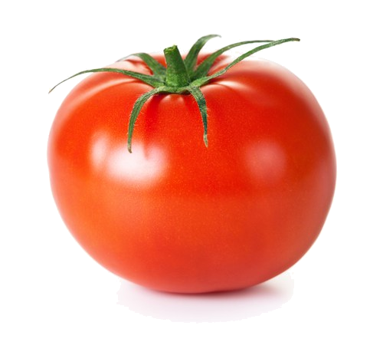
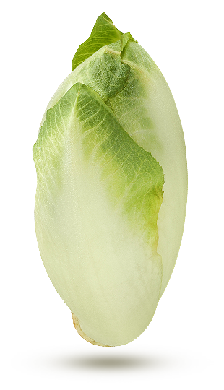
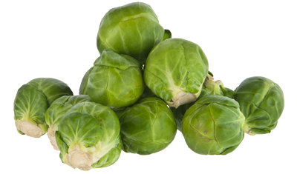
Favorite french’s vegetables
Disliked french’s vegetables
14kg
11kg
6.8kg

Slide 4
II. Consumption in values
75%
Types | Quantities per person per year
Yoghurt | 21.4kg (= 170 cups)
Bread | 43 kg (= 180 baguettes)
Cheese | 26 kg (=100 camemberts)
Meat | 86kg (50kg is beef)
Potatoes | 30kg (300 potatoes)

Slide 5
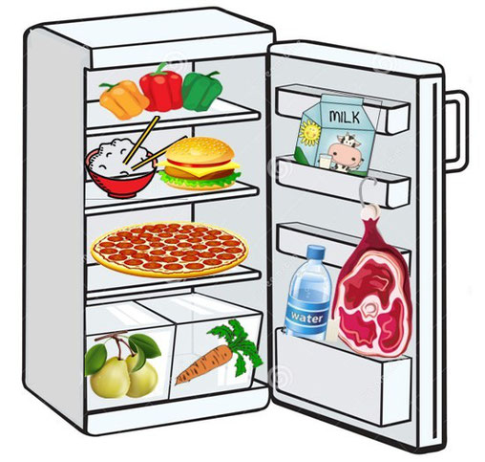
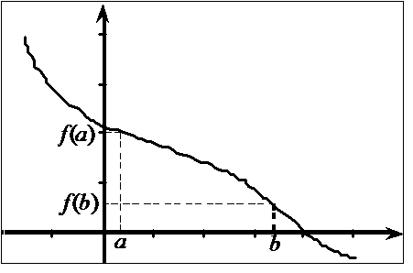
III. Some problems
Too much salt
Too much industrial food
Bad organization
Not enough fibers
(20% more is the objective)
Bad use of food
supplements

Slide 6
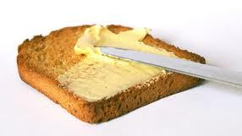
IV)Meals during the day
French people are very rigorous :
Breakfast : 6 a.m – 8 a.m
Lunch : 12 a.m - 2 p.m
Diner : 6 p.m – 8 p.m
Breakfast :
Hot drink (tea, coffee, chocolate…)
Bread
Jam and butter

Slide 7
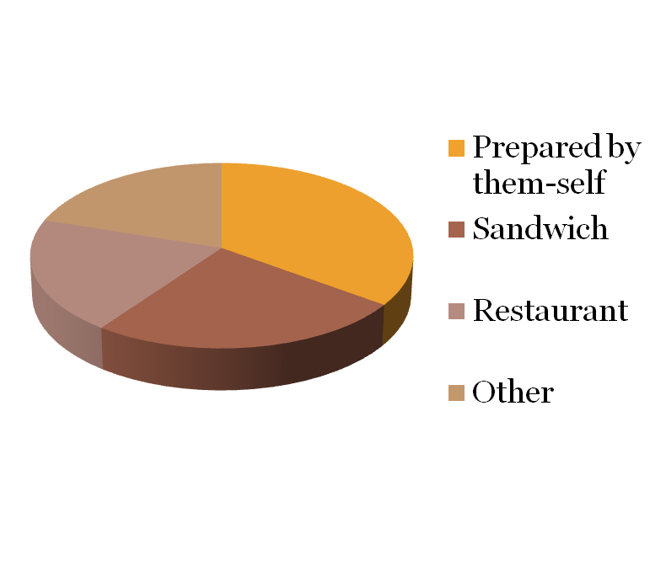
At midday :
2.39 million/year
eat “ham and butter” sandwiches
(half of sandwich eaters)
20%
35%
20%
25%

Slide 8
At the evening :
Meal in 3 parts :
Appetizer
Dish
Dessert
People are
served 1 by 1

