Slide 1
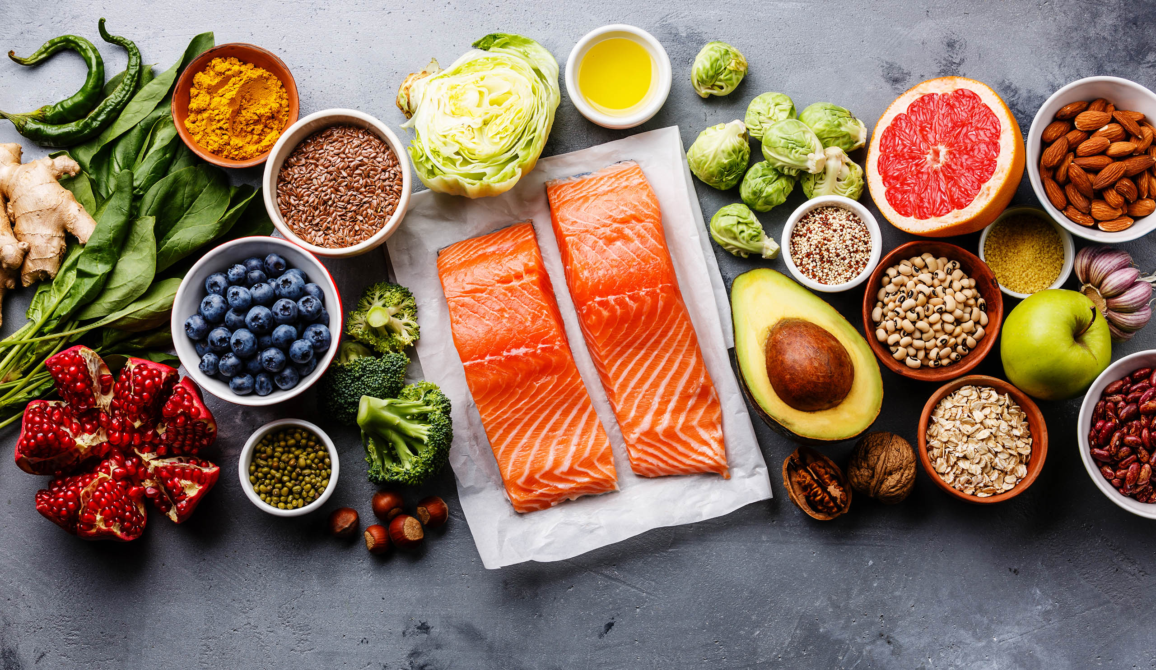
THE MEDITERRANEAN DIET

Slide 2
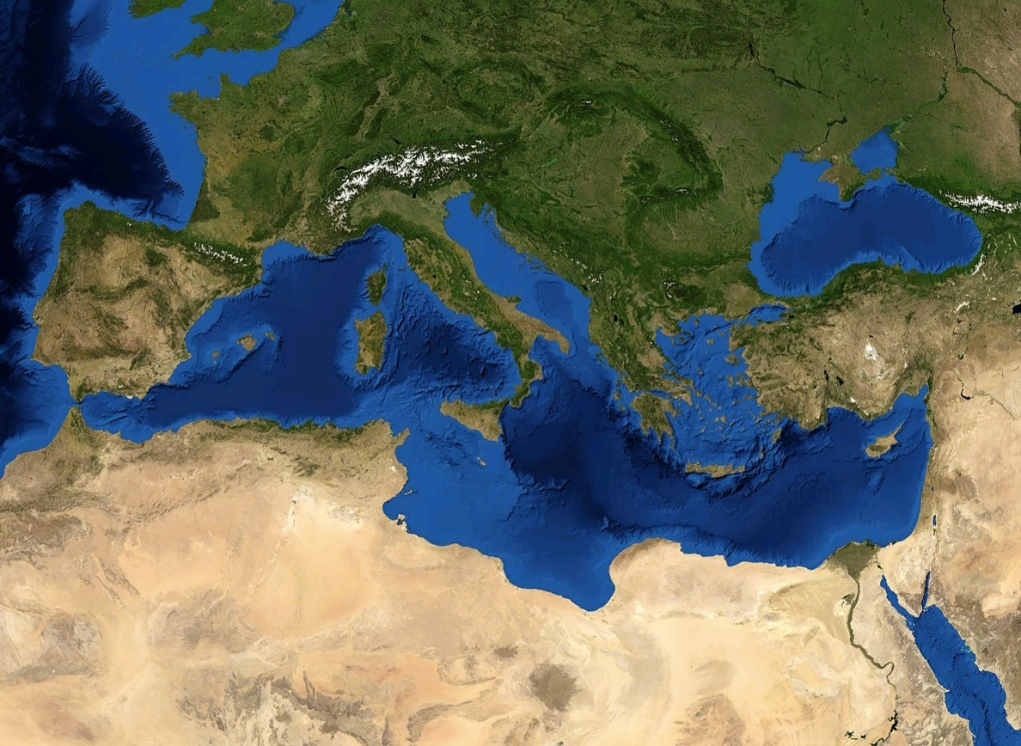
According to the majority of the nutritionists, the Mediterranean diet is the healthiest one .
It is based on the traditional eating habits from the people living in countries that surround the Mediterranean Sea, such as Greece, Italy, and Spain, and it encourages the consumption of fresh, seasonal, and local foods.

Slide 3
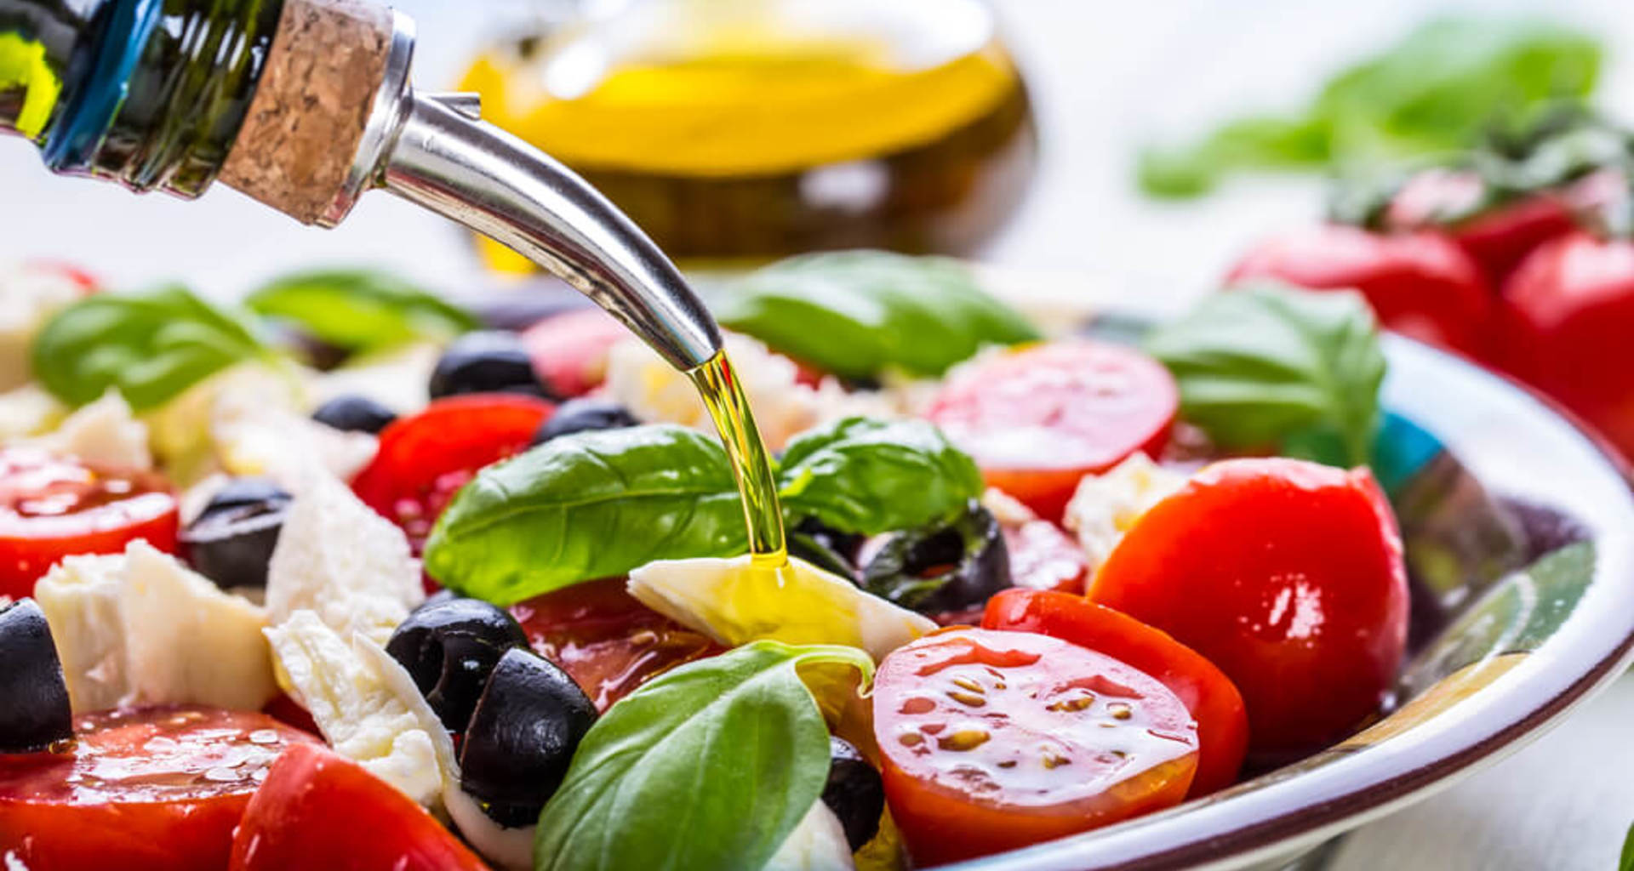
This diet is generally characterized by a high intake of:
fresh fruit
vegetables
nuts
cereals
olive oil…

Slide 4
… a moderate intake of:
fish
poultry…
… and low intakes of:
diary products (mostly yoghurt and cheese)
red and processed meats
sweets.

Slide 5
Wine is consumed in moderation and, normally, with a meal.

Slide 6
A strong focus is placed on social and cultural aspects, such as shared mealtimes, resting after eating and regular physical activity.

