Slide 2
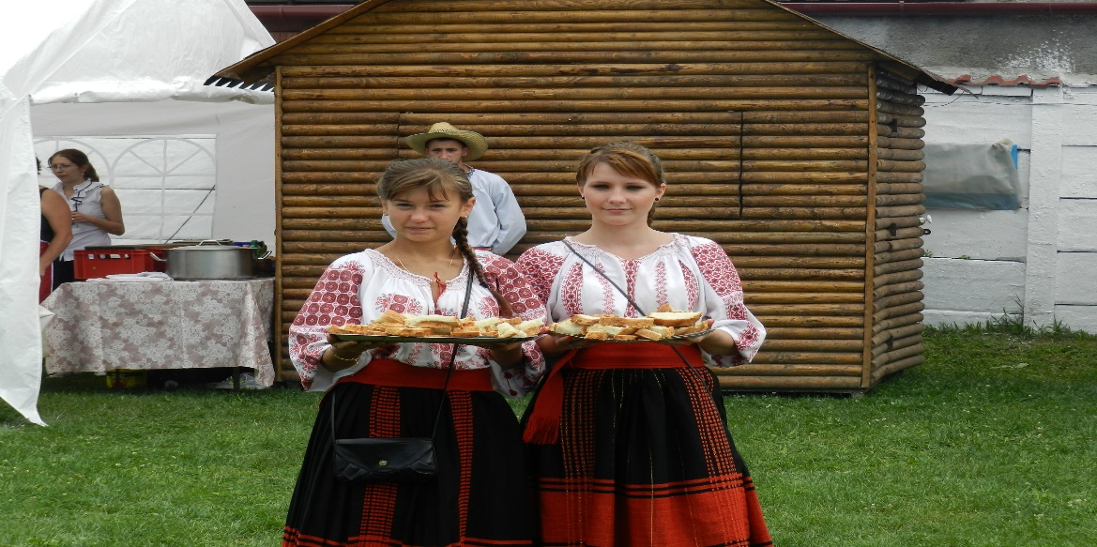
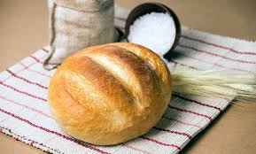
ROMANIAN CUISINE: TRADITIONAL ROMANIAN DISHES
Romanian cuisine is hearty, flavorful, and heavily influenced by the peoples that the area has come into contact with. Every people has weird food rituals, habits and customs. Romanians have their share of less usual eating combos and pretty weird food fusions. You can just have a few bites and blend in or just smile and wave!
If you have been visiting a few European countries by now, especially the Slavic ones, you won’t feel too much surprised when people will show up wearing their prettiest national costumes and inviting you to take a bite of home-baked bread and dip it in salt. It’s just their way of welcoming guests and expressing hospitality and kindness.

Slide 3
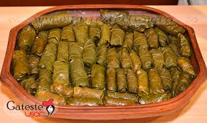
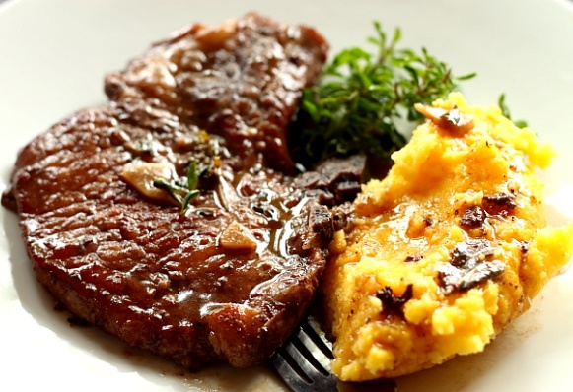
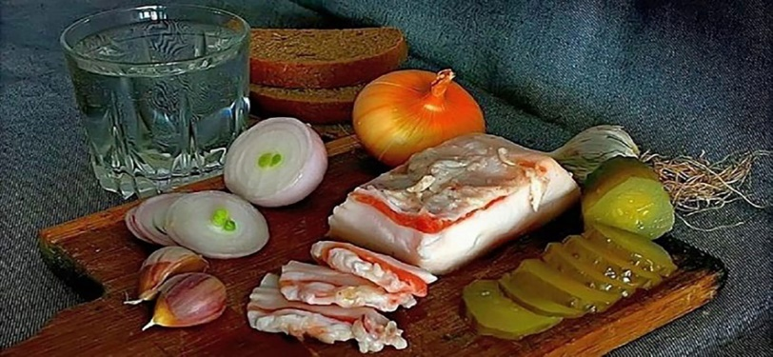
Major influences have come by way of the Ottoman Empire as well as the Greeks. For example, the Turks brought meatballs and meat filled cabbage rolls (“sarmale”) with them; whereas the Greeks came with the moussaka (“musaca”). Also, what you may not already know is that cuisines of neighboring countries (Serbia and Hungary) have played an important part in ‘shaping’ Romanian cuisine too!
Romania’s cuisine includes a lot of pork meat but during the Lent period, there are a variety of plant-based dishes to be enjoyed, making the cuisine quite interesting.
If we are to talk about super traditional mixes that trigger our taste buds, then the classic homemade bread/ smoked lard (called slana)/ onion is the absolute favourite. Don’t forget to accompany it with a good shot of țuică (Romanian brandy)!

Slide 4
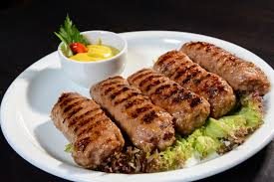
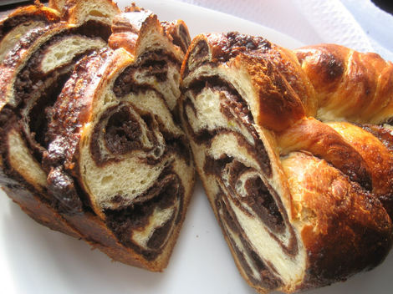
Another classic combo that you need to try has to be mititei (aka mici) with bread and well dipped in mustard (the local Tecuci mustard is a must-try). Just keep in mind to grab a cold beer to have with that. Any local brand will do!
The Easter feast gives plenty of opportunities to have the most unusual food treats. We like to eat the lamb haggis (drob) with cucumber or with spring onions dipped in salt. We simply cannot have the spring onions without dipping it in salt.
As we mentioned the holiday feasts, we like our Romanian Sweetbread (cozonac) accompanied by hard boiled Easter eggs and some warm milk or yogurt during Christmas. Some might even dip it in mulled wine. Yep, we pretty much dip everything. At least this is how it looks like…
Christmas plate

Slide 6
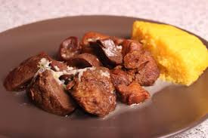
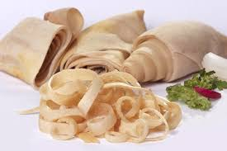
The Christmas Holidays are usually celebrated with pork dishes, as in the winter period, on December 20th, tradition says it is the time to butcher the pigs (Ignat). Even if people are not doing it anymore in the cities, there is still the tradition to gather the families at the countryside farms for this ritual, where the pigs are fed and taken care of the entire year, preparing for this moment.
There are some dishes which are usually prepared right after the sacrifice moment, such as Pomana Porcului (Pork Feast), when parts of the fresh meat are fried in fat and served to guests and helpers. Another specific dish is the salted Pork rind (Sorici), pork skin from softer parts, which can be eaten uncooked or boiled with garlic.

Slide 8
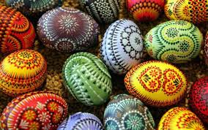
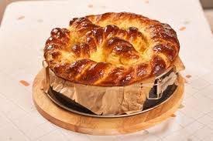
After fasting during 48 days (the Lent is the longest fasting period in the Orthodox Calendar), Romanians celebrate with culinary specialties including Easter eggs, various salads with mayonnaise dressing, filled eggs (with a pasta made of yolks, mustard, mayonnaise, pepper), lamb specialties like Haggis (Drob), and Turkish delight (rahat) filling or with sweet cheese and raisins (called Pasca – this is the Easter traditional cake).
Pasca is the Romanian cheesecake, traditionally baked for Easter. A crumbling dough on the bottom on which a mixture of cottage cheese, sugar, eggs, and raisins is added on top and then baked. Each region has a different way to make the dough and filling – but one thing is for sure, they are all delicious!

