Slide 1
FOOD METABOLISM
Colegiul Tehnic ,,Lațcu Vodă” Siret

Slide 2
INTRODUCTION
The human body requires fuel as well as materials to develop, grow and heal.
Nutrients are chemical substances supplied by the environment required for survival:
• Macronutrients
Carbohydrates
Proteins
Fats
• Micronutrients
Vitamins
Minerals
Essential nutrients
Nutrients human cells cannot synthesize such as certain amino acids.

Slide 3
Metabolism
Metabolism – process by which living systems acquire and use free energy to carry out vital processes
Catabolism (degradation)
Nutrients and cell constituents are broken down for salvage and/or generation of energy
Anabolism (biosynthesis)
Synthesis of biological molecules from simpler precursors
- The process needs energy.

Slide 4
CARBOHYDRATES
Carbohydrates are organic compounds and include sugars and starches.
The energy in their chemical bonds are used to power cellular processes.
Excesses lead to:
• Obesity
• Dental cavities
• Nutritional deficits
Deficiencies lead to:
• Metabolic acidosis
• Weight loss

Slide 5
CARBOHYDRATE SOURCES
Carbohydrates are ingested in a variety of forms:
• Complex carbohydrates are polysaccharides that include:
• Starch from plant foods
• Glycogen from meats
• Simple carbohydrates are:
• Disaccharides from milk sugar, cane sugar, beet sugar and molasses
• Monosaccharides from honey and fruits
Digestion breaks complex carbohydrates into monosaccharides that are small enough to be absorbed.
Cellulose is a complex carbohydrate abundant in our food. It is not digested, but provides bulk (fiber or roughage).

Slide 6
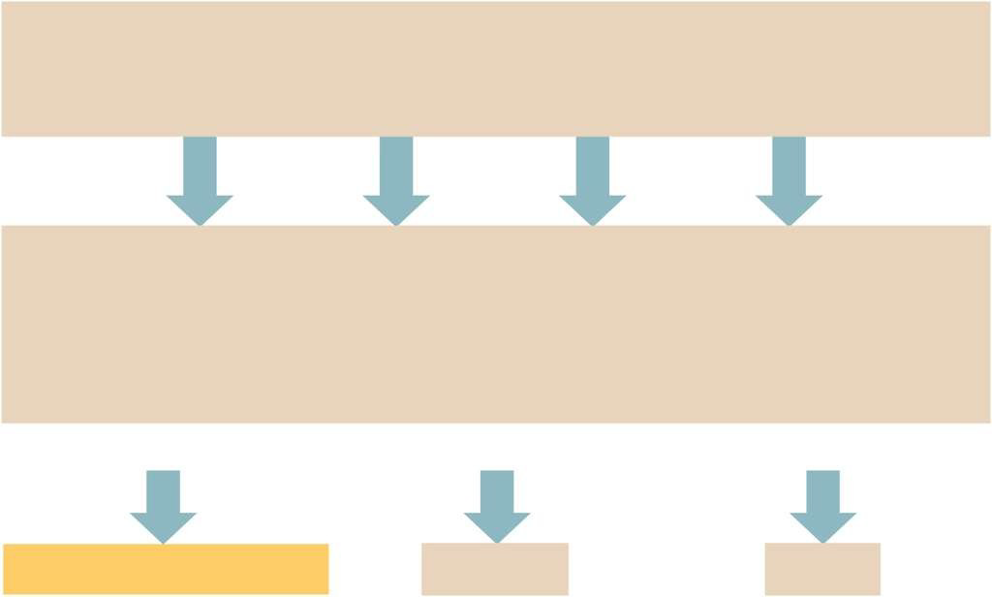
Monosaccharides that are absorbed include fructose, galactose, and glucose
Carbohydrates
Starch
Sucrose
Maltose
Lactose
Glucose
Glucose
and
Fructose
Glucose
and
Galactose
Glucose
Monosaccharides
Respiration
Glycogenesis
Lipogenesis
CO2 + H2O + Energy
Glycogen
Fat

Slide 7
CARBOHYDRATE REQUIREMENTS
The minimal requirements for carbohydrates in the human diet is unknown.
Intake of at least 125 – 175 grams is necessary.
An average diet includes 200-300 grams.

Slide 8
LIPIDS
Lipids are organic compounds that include fats, oils, and fat-like substances such as phospholipids and cholesterol.
They supply energy for cellular processes and help to build structures like cell membranes.
The most common dietary lipids are fats called triglycerides.
Excesses lead to:
Obesity
Increased serum cholesterol
Increased risk of heart diseases
Deficiencies lead to:
Weight loss
Skin lesions
Hormonal imbalances

Slide 9
LIPID SOURCES
Triglycerides are found in plant-based and animal-based foods and include:
From plants:
- Seeds
- Nuts
- Plant oils (olive, peanut and canola are the healthiest)
From animals:
- Meat
- Eggs
- Milk
- Lard

Slide 10
LIPID USE
Lipids in foods are phospholipids,
cholesterol and most commonly, fats (triglycerides).
• They are oxidized for energy.
• They are stored in adipose tissue.
• Glycerol may be used to synthesize glucose.

Slide 11
Triglycerides
Digestion
Fatty acids + Glycerol
Liver
Triglycerides Phospholipids
Lipoprotein Cholesterol
Fatty acids
(except essential fatty acids)

Slide 12
LIPID REQUIREMENTS
The lipid content of human diets varies widely.
The World Health Organization advises that the diet not exceed 30% of total daily calories from fat (out of which maximum 1/3 saturated fats).

Slide 13
PROTEINS
Proteins are polymers of amino acids.
They have a wide variety of functions, including building more protein (structural protein, enzymes, hormones, and plasma proteins) and supplying energy.
The waste product of protein metabolism is urea.
Excesses lead to obesity.
Deficiencies lead to:
- Extreme weight loss
- Muscle wasting
- Anemia
- Growth retardation

Slide 14
Protein
Digestion
Amino acids
Proteins Energy Glucose
Fat
- Structural proteins
- Enzymes
- Hormones
- Plasma proteins

Slide 15
PROTEIN SOURCES
Foods rich in proteins include:
Meats
Fish
Poultry
Cheeses
Nuts
Milk
Eggs
Cereals
To some degree legumes (beans and peas)
The body needs 20 types of amino acids; those that can be synthesized by the body are non-essential amino acids (12) and those that cannot are essential amino acids (8).

Slide 16
NITROGEN BALANCE
In healthy adults, protein is continuously built up and broken down.
Proteins contain a high percentage of nitrogen.
The amount of nitrogen taken in is equal to amount excreted.
- Negative nitrogen balance develops from starvation.
- Positive nitrogen balance develops in growing children, pregnant women, or an athlete in training.

Slide 17
PROTEIN REQUIREMENTS
In addition to supplying essential amino acids, proteins provide nitrogen and other elements for the synthesis of nonessential amino acids and certain non-protein nitrogenous substances.
The dietary amount varies according to body size, metabolic rate, and nitrogen balance condition.
Typically protein intake is 10% of a person’s diet.
Most people should consume 0.8 -1grams/ body kg / day.

Slide 18
ENERGY EXPENDITURES
Carbohydrates, fats and proteins supply energy for all metabolic processes
Deficiencies can lead to death
Excesses can lead to obesity

Slide 19
ENERGY VALUES OF FOOD
A calorie indicates the amount of potential energy a food contains
Calories can be measured from the content of foods
The rate that the body expends energy at rest can be measured and is known as basal metabolic rate (BMR)
This varies for:
Carbohydrates -4.1 calories per gram
Lipids - 9.5 calories per gram
Proteins - 4.1 calories per gram

Slide 20
ENERGY REQUIREMENTS
Basal metabolic rate (BMR):
The rate at which body expends energy at rest
This primarily reflects energy needed to support the activities of the organs
This varies with gender, body size, body temperature, and endocrine function
Energy is needed:
To maintain BMR
To support muscular activity
To maintain body temperature
For growth in children and pregnant women

Slide 21
ENERGY BALANCE
Energy balance occurs when caloric intake in the form of food equals caloric output from BMR and muscular activities
The body weight remains constant
If, however, caloric intake exceed output, tissues store excess nutrients
This is a positive energy balance that leads to weight gain

Slide 22
DESIRABLE WEIGHT
Most common nutritional disorders involve caloric imbalances
Desirable weight is difficult to determine
Body Mass Index (BMI) is used today to assess weight considering height
A person is classified with BMI as either underweight, normal weight, overweight, or obese
- Overweight is defined as exceeding desirable weight by 10% - 20%, or a BMI of 25 and 30
- Obesity occurs when a person is more than 20% above desired weight, or with a BMI over 30

