Slide 1
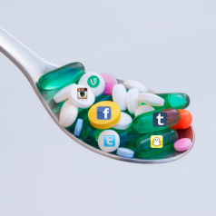
Internet addiction

Slide 2
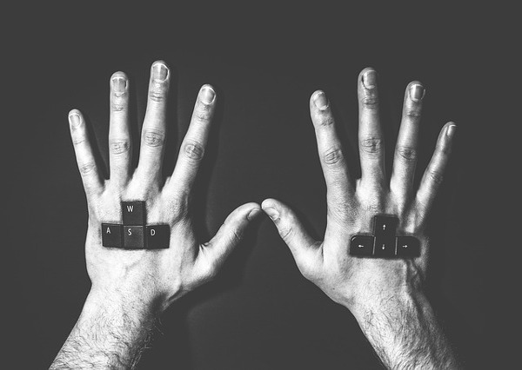
Explanation
Looking at it from a psychological point of view, an addiction to the Internet’s a new kind of addiction, it is spending your whole time on surfing the Internet or just doing anything on the computer.
An addicted person
"has to do it”." be online.

Slide 3
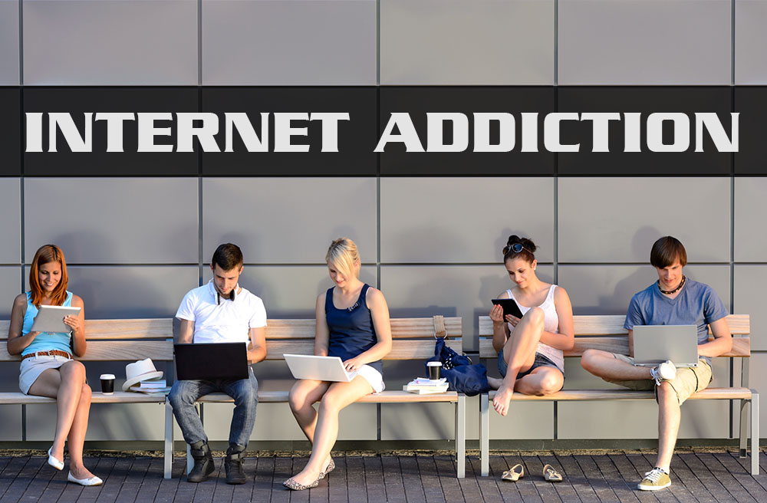
Causes
Escaping from real life
Kid's problems in the interpersonal contacts
Easy access,popularity of the media
You can be anyone you want to be
on the Internet

Slide 4
Effects of Internet addiction
Depression
Aggression, exasperation
Cyberbullying
Conflicts with the closest
A sense of loneliness

Slide 5
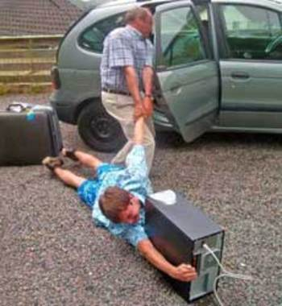
Effects of addiction
Remissness
Demotivation
The disappearance of emotional ties
Stop developing your interests

Slide 6
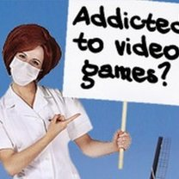
Treatment
Unlike from the others addictions, in case of curing an Internet addiction, or computer addiction, there is an additional problem. People with this addiction are hard to make them to talk "face to face" with the specialist, because they are used to communicate by the keyboard.

Slide 7
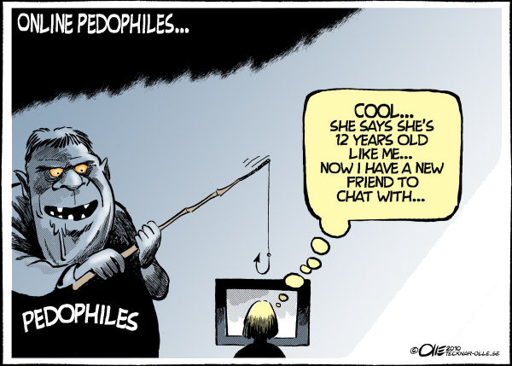
Pedophilia on the internet
The biggest danger waiting on kids are pedophiles. Teenagers and kids often need a person who will help, advise. Pedophiles are giving their kindness, attention and care. They can listen, they give you understanding. They act very fast. They start conversation with erotic personality. Endeavor to meeting "face to face".

Slide 8
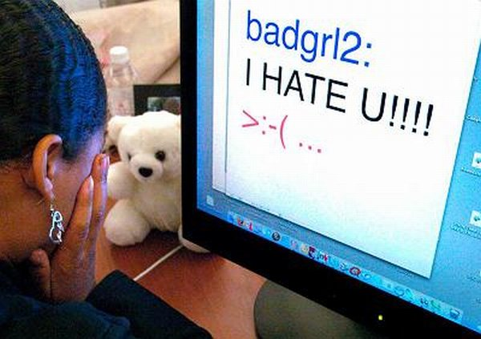
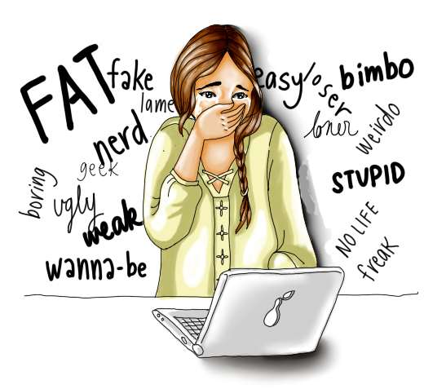
There is also on the internet:
Cyberviolence (electronic violence) - using violence by bullying other people by Internet, RTV, text message, e-mail, discussion forums in Internet and others. A person who does those things is called a stalker.
Cyberviolence

Slide 9
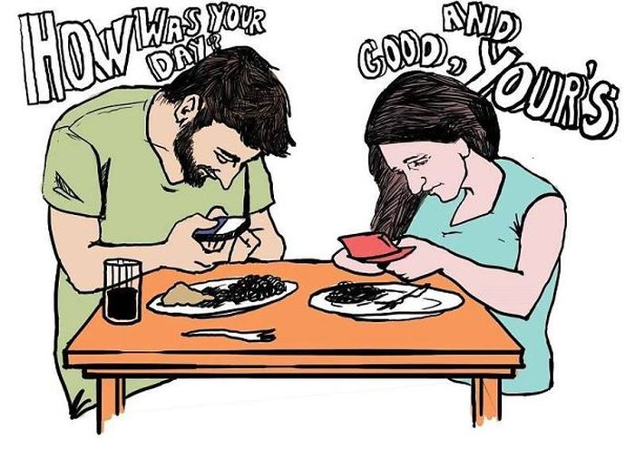
Addiction to the phone
Mobile phone overuse
is a dependence syndrome seen among certain mobile phone users. Some mobile phone users exhibit problematic behaviors related to substance use disorders. These behaviors can include preoccupation with mobile communication, excessive money or time spent on mobile phones, use of mobile phones in socially or physically inappropriate situations such as driving a vehicle.

Slide 10
Addiction to the phone
Increased use can also lead to increased time on mobile communication, adverse effects on relationships, and anxiety if separated from a mobile phone or a sufficient signal.

Slide 11
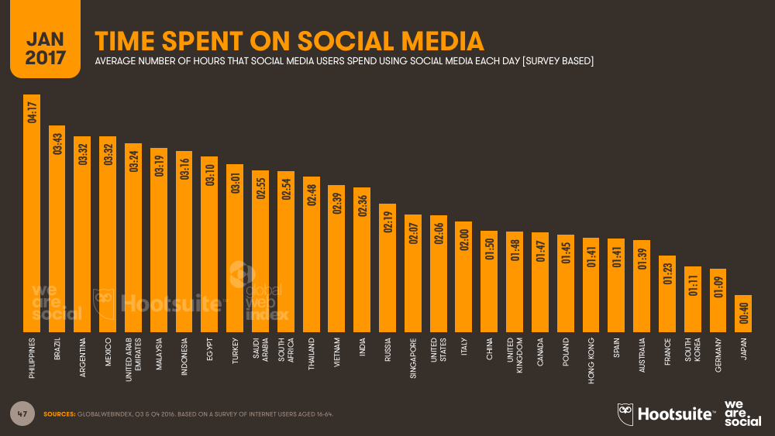

Slide 12
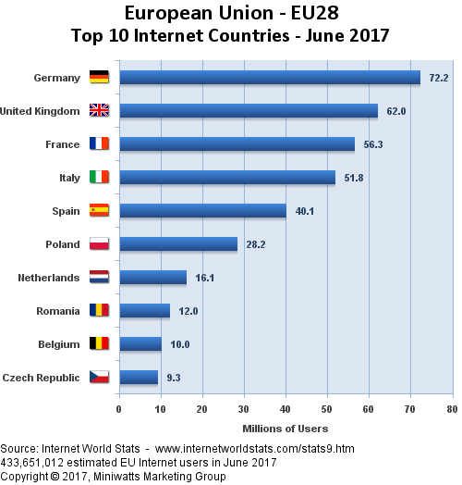
Internet addiction statistics in 2017

Slide 13
Thank you for your attention
Aleksandra Bogutyn

