Slide 1
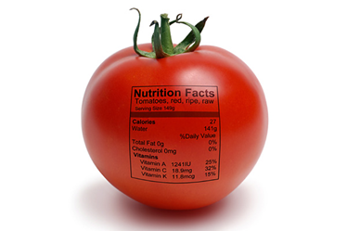
ERASMUS+KA2 MOVING2HEALTH
LABELLING IN ITALY

Slide 2
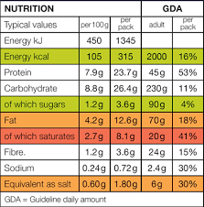
COMPULSORY ELEMENTS FOR LABELLING
NAMES OF NUTRITIVE SUBSTANCES PRESENT IN THE PRODUCT AND RECOMMENDED DOSES FOR DAILY CONSUMPTION (GDA)

Slide 3
COUNTRY OF ORIGIN OF THE PRODUCTS

Slide 4
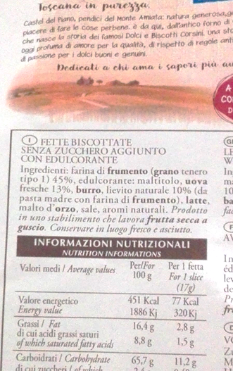
Labelling
The label is an obligation for the seller who sells a food product, but also represents an instrument for communicating commercial information to the consumer.
According to the Italian Law ,labels are produced transparently and give important information for the consumer
Ingredients that could cause allergies must be reported as substances defined as allergens with a distinctly character from the others(for example wheat, gluten carrier, eggs, butter because it is a carrier of milk, nuts, etc.)
The nutritional label became mandatory starting from December 13th 2016 regarding the declaration of the caloric content (energy), fats, saturated fats, carbohydrates with specific reference to sugars and salt, expressed as quantity per 100g or per 100 ml or per portion.

Slide 5
Labelling
The focus here is on the nutritional information given on the label and on the expiry date.
nutritional information refer both to the single portion (1 biscuit, 1 slice) and to a standard amount of 100 grams.
The percentage of saturated fatty acids is also expressed in the label. This is important because these fats could be very harmful to our health.
The expiry date on the label in the picture, indicates that the product could be preferably consumed within the written date beyond which the product does not become a danger to our health if consumed, but perhaps loses some of the characteristics or for example the crunchiness, the perfume, the taste.
On some products we can read "to be consumed within", in this case the product consumed after the indicated date ,could cause problems.
The code after L indicates instead the production lot, which identifies the product

Slide 6
Biological product labelling
This label refers to a biological product.
The symbol "℮", inserted after the indication of the quantity on the label of a product, indicates that the producer fulfills the law n.690/78 for "prepackaged packaging C.E.E" (DM451 / 1976).
The conversion in ounces is probably a product also destined to foreign markets, as we find the translation of the list of ingredients.

Slide 7
BIOLOGICAL PRODUCT LABELLING
This label clearly shows the correct indication of an organic product, recognized by the Italian Ministry for Agriculture.
The logo that we can see, is nothing more than the official logo of organic farming in the European Union, and aims to make easily recognizable to the consumer a product derived from a biological process, certified by a third body officially recognized for its function

Slide 8
Transparent label
The "Riso Semintegrale Chinese Originario" is an old variety of rice that in Italy began to spread around 1904, it was also called "abundance" because it was very productive.
With the advent of chemistry and intensive cultivation, this variety was abandoned because it did not adapt to the needs of extreme agriculture.
But today this type of rice is produced again with a unique transparent label

Slide 9
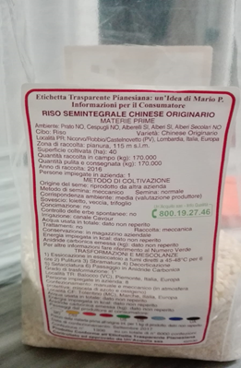
Transparent label
This is the only product in Italy with a transparent flat label which takes its name after Mario Pianesi.( Etichetta Pianesiana)
This kind of label, developed as early as the 1980s, is a definitive tool for the protection of consumers and the environment.
Every product with this type of label allows to track the presence of harmful compounds in food. It is an instrument of prevention and guarantee for a healthy and certified diet.
It concerns anyone who wants to eat more consciously. But it is essential in the daily management of patients with diabetes and related diseases.

Slide 10
THANKS FOR YOUR ATTENTION
Antonio Calabrese
Michele Fanelli
LICEO SCIENTIFICO G.GALILEI – POTENZA

