Slide 1
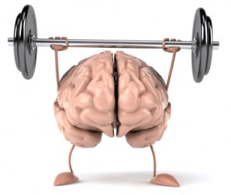
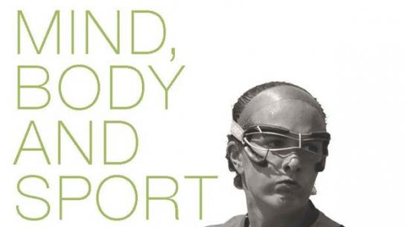
Mental health through sport

Slide 2
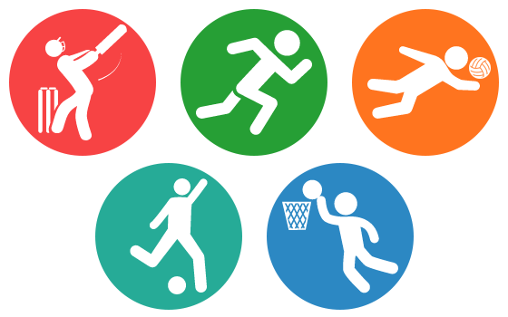
How sport affects mental health?
1. Sports improve your mood
Want a burst of happiness and relaxation? Get involved in a physical activity. Whether you are playing sports, working out at a gym, or taking a brisk walk, physical activity triggers brain chemicals that make you feel happier and more relaxed.

Slide 3
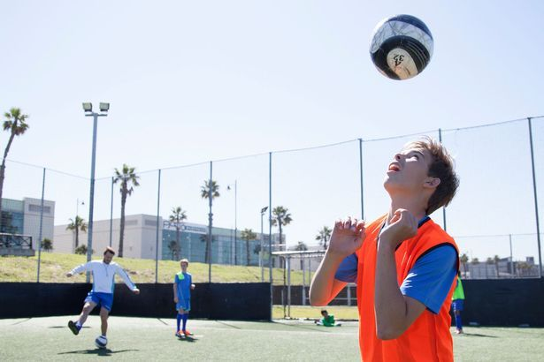
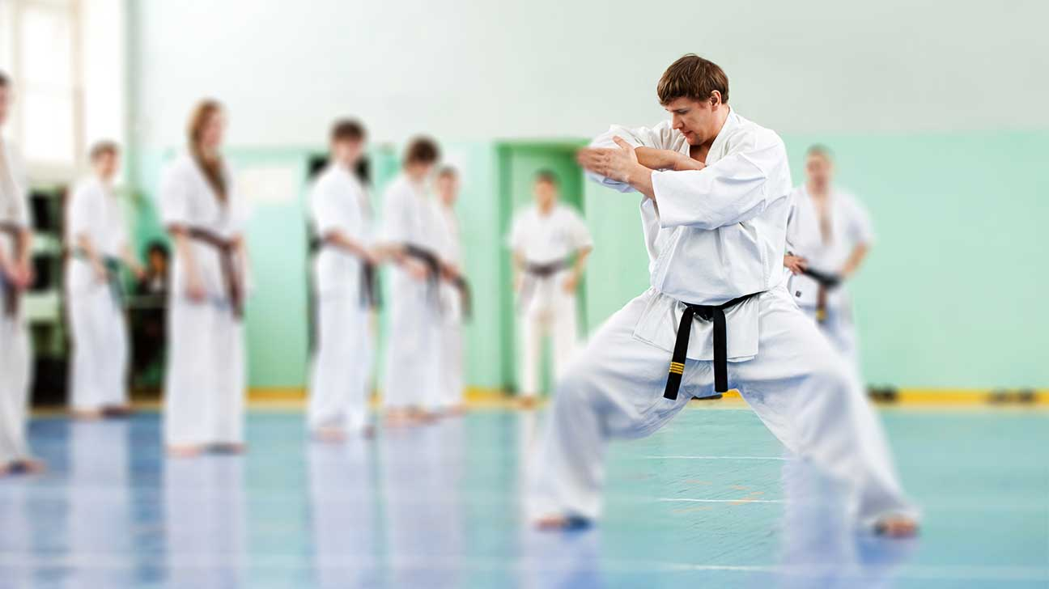
2. Sports improve your concentration
Regular physical activity helps keep your key mental skills sharp as you age. This includes critical thinking, learning, and using good judgment. Research has shown that doing a mix of aerobic and muscle-strengthening activities is especially helpful.

Slide 4
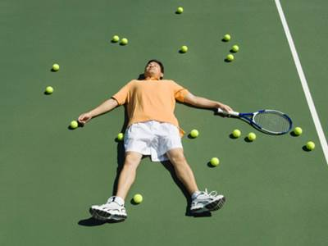
3. Sports reduce stress and depression
When you are physically active, your mind is distracted from daily stressors. This can help you avoid getting bogged down by negative thoughts. Exercise reduces the levels of stress hormones in your body. At the same time, it stimulates production of endorphins. These are natural mood lifters that can keep stress and depression at bay.

Slide 5
4. Sports improve sleeping habits
Sports and other forms of physical activity improve the quality of sleep. They do this by helping you fall asleep faster and deepening your sleep. Sleeping better can improve your mental outlook the next day, as well as improve your mood.

Slide 6
5. Sports help you maintain a healthy weight
The Centers for Disease Control and Prevention (CDC) recommend sports participation as a healthy way to maintain weight. Individual sports, such as running, cycling, and weightlifting, are all particularly effective ways to burn calories and/or build muscle.

Slide 7
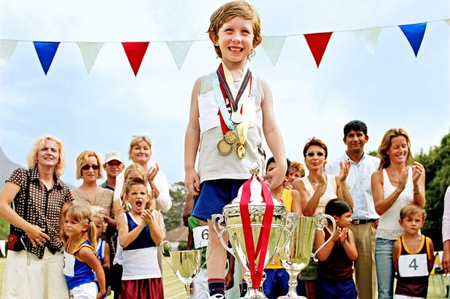
6. Sports boost your self-confidence
The regular exercise that comes with playing sports can boost your confidence and improve your self-esteem. As your strength, skills, and stamina increase through playing sports, your self-image will improve as well.

Slide 8
7. Sports have been linked to leadership traits
Team sports such as soccer, baseball, and basketball are breeding grounds for leadership traits. Studies done in high schools reveal a correlation between sports participation and leadership qualities. The team mindset leads to strong leadership qualities over time.

Slide 9
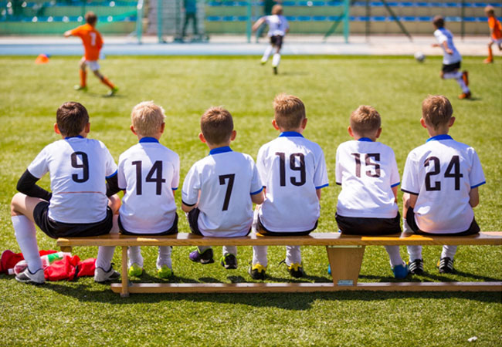
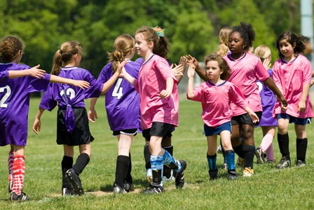
Benefits for children
Sports can benefit children in many of the same ways that they benefit adults. The biggest difference is that when children start participating in sports at a young age, they are far more likely to stay active as they grow older.

Slide 10
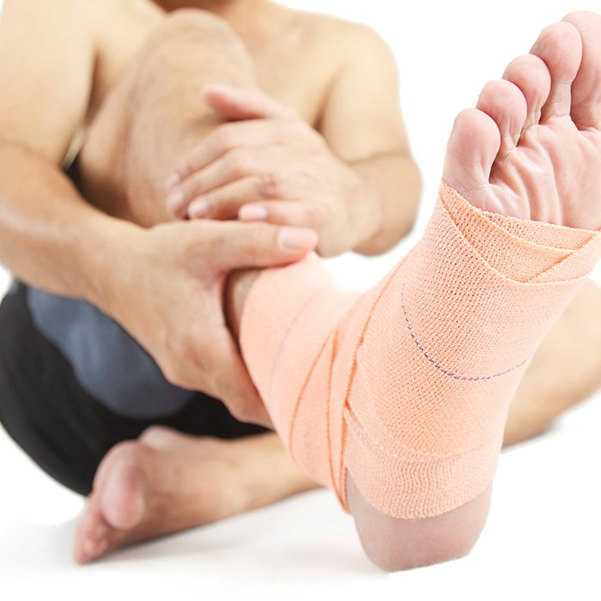
What to keep in mind
Some popular team sports, including American football and ice hockey, commonly result in injuries. Frequently reported sports injuries include sprains, contusions, and broken limbs. Most sports injuries will result in a complete recovery if there is proper medical attention. However, some injuries, such as brain trauma and concussion, can cause permanent, lifelong damage to the athlete.

Slide 11
THANKS FOR WATCHING

