Slide 1
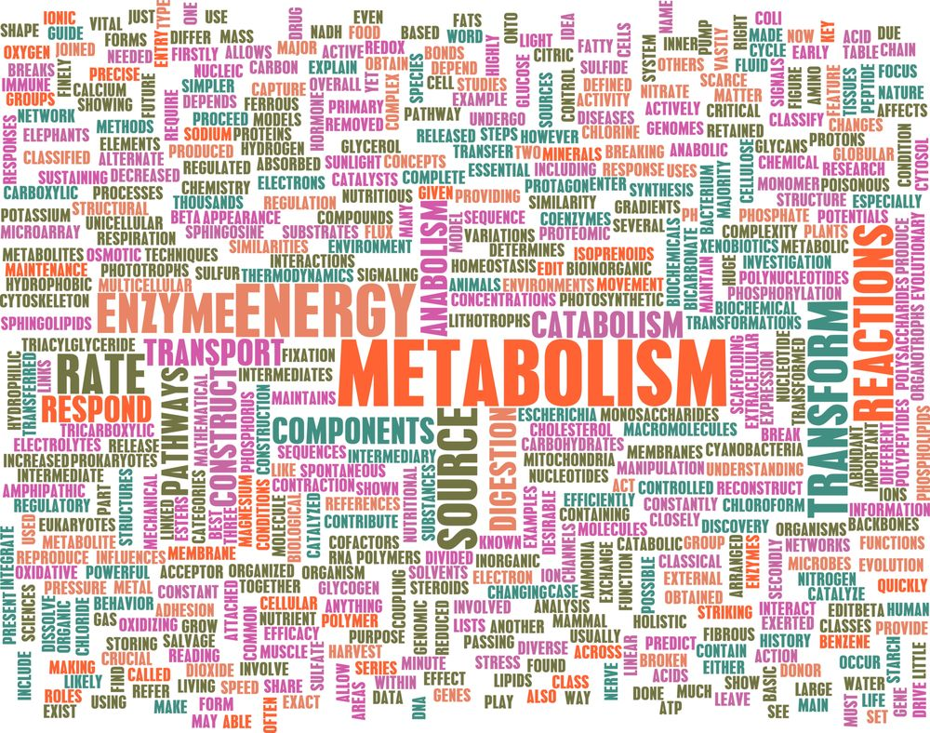
Erasmus+kA2 Moving2Health

Slide 2
METABOLISM
All chemical reactions involved in maintaining the living state of the cells and the organism
Metabolism can be conveniently divided into two categories:
CATABOLISM
The breakdown of molecules to obtain energy
ANABOLISM
the synthesis of all the components needed by the cells

Slide 3
NUTRITION THE KEY TO METABOLISM

Slide 4
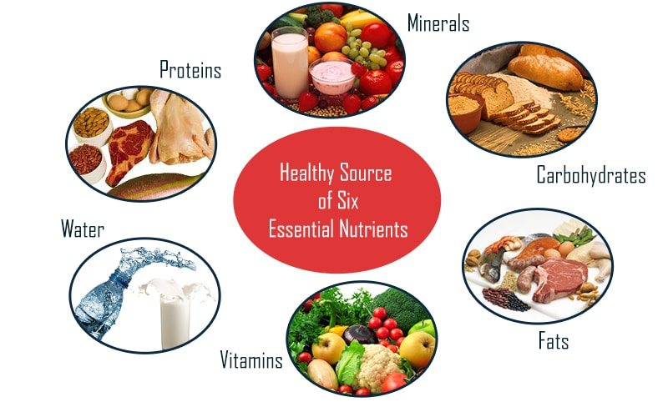
NUTRIENTS
breakdown in order to produce energy. This energy in turn is required by the body to synthesize new proteins, nucleic acids (DNA, RNA) etc.
supply energy (calories) and supply the necessary chemicals which the body itself cannot synthesize.

Slide 5
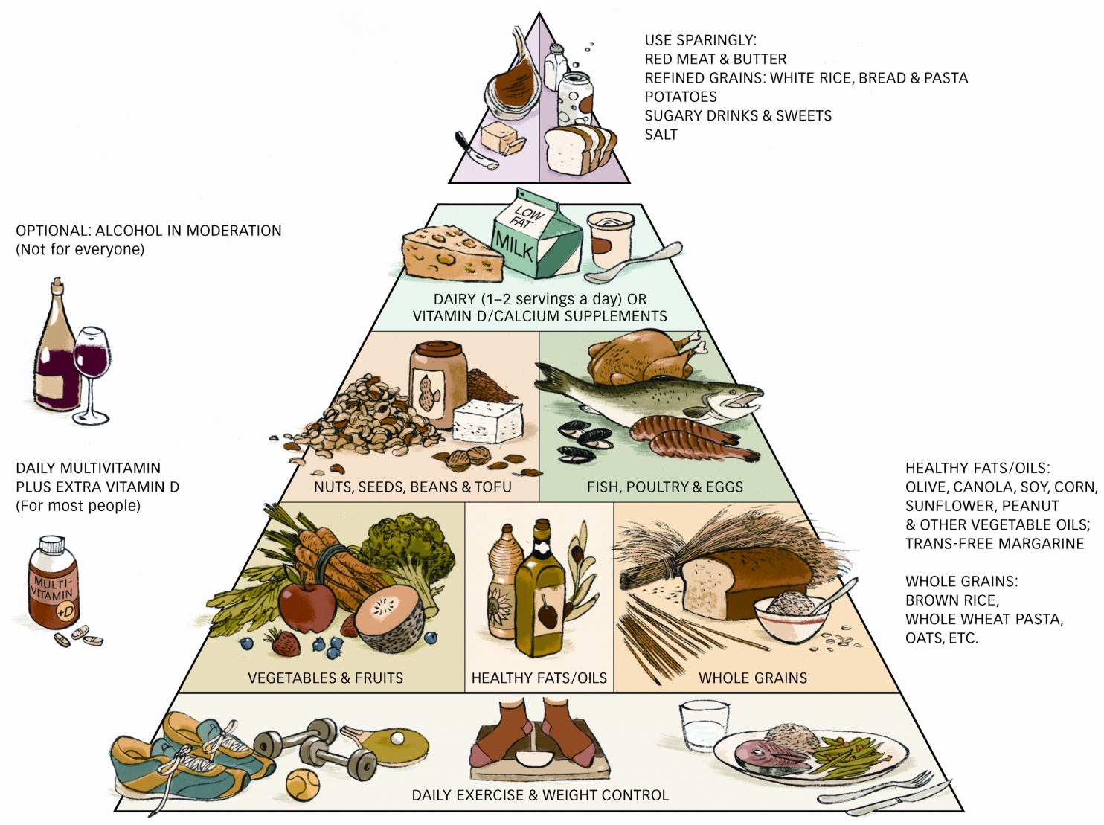
FOOD
provides a variety of substances that are essential for the building, upkeep and repair of body tissues and for the efficient functioning of the body.

Slide 6
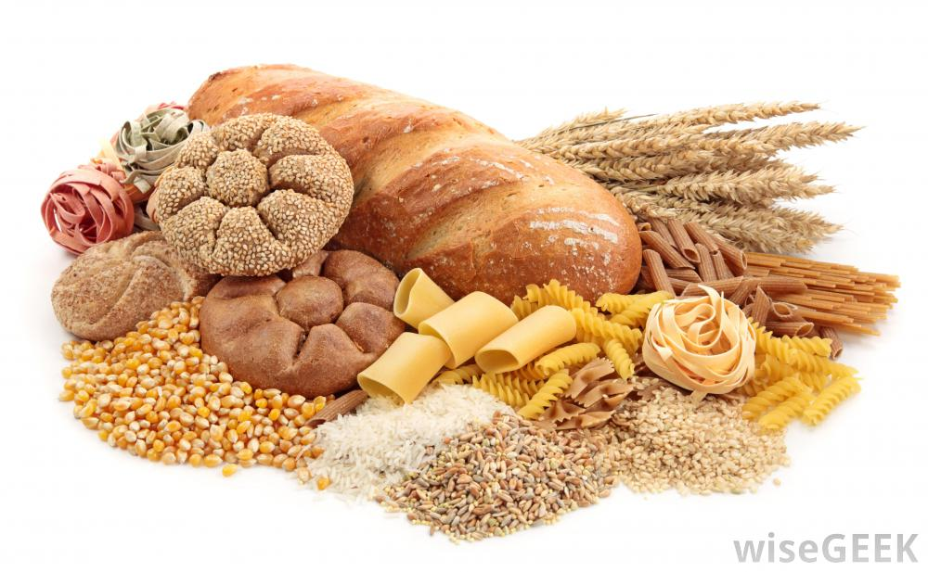
CARBOHYDRATES
starch, sugar and cellulose (fiber)
Body tissues depend on glucose for all activities.
Carbohydrates and sugar yield glucose by digestion or metabolism.
The combustion of glucose produces a lot of energy
Most people consume around half of their diet as carbohydrates. This comes from rice, wheat, bread, potatoes, pasta, etc.

Slide 7
PROTEINS main tissue builders in the body
they carry out vital reactions and a myriad of other functions
they are necessary for nutrition because they contain amino acids

Slide 8
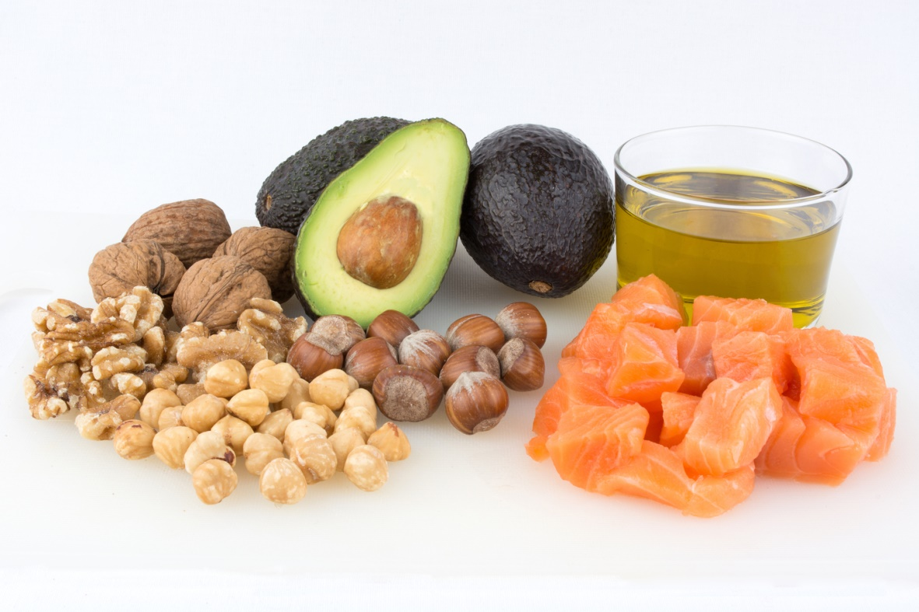
FAT sources of energy
Functions:
helping to form the cellular structure;
forming a protective cushion and insulation around vital organs;
helping absorb fat soluble vitamins,
providing a reserve storage for energy

Slide 9
THANKS FOR YOUR ATTENTION
Clelia Bernardo
Miriam Panebianco
Liceo Scientifico Galileo Galilei
Potenza
Italy

