Slide 1
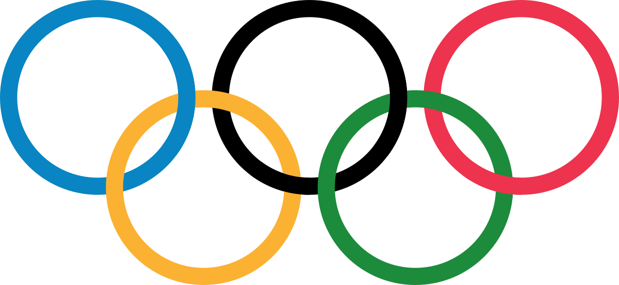
THE OLYMPIC GAMES
COLEGIUL TEHNIC LATCU VODA SIRET

Slide 2
Introduction
The Olympic Games are an international sports competition which are held every four years in a different city. Thousands of athletes from all over the world compete against each other in individual and team sports.
Over 1 billion people watch the games on TV.
The first Olympic Games were held in Greece in 776 B.C. They were called the Ancient Games and lasted until the 4th century A.D. The modern games began in 1896, when the Frenchman Pierre de Coubertin revived the games to bring peace and friendship to the young people all over the world.
Today, there are summer and winter games. Up to 1994 both games were held in the same year, but now they are staged two years apart from each other.

Slide 3
Ceremonies and symbols
The Olympic Games begin with the opening ceremony.
Athletes from all the participating nations march into the stadium.
Greece comes in first.
The Olympic flag is raised and a chosen athlete lights the Olympic flame.

Slide 4
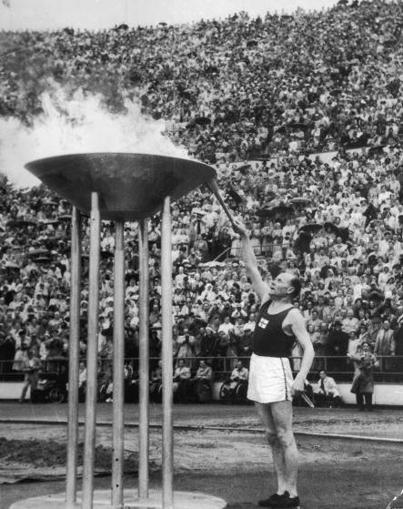
The Olympic rings were created in 1913 and represent the five continents (Africa, Asia, Europe, Australia and the Americas).
All athletes must take the Olympic oath.
After each event, medals are given to the first three athletes. They receive gold, silver and bronze medals. Their flags are raised and the national anthem of the winner’s country is played.

Slide 5
The International Olympic Committee
The IOC is the organisation that governs the games. It decides which sports and events are held at the games. Cities that want the games must show that
they have enough stadiums for all events
they have enough room for all the athletes
they can provide safety for the athletes
they can transport athletes and spectators from one event to another
Host cities must build an Olympic village where all athletes live during the games.

Slide 6
How can athletes take part ?
Each country decides for itself which sportsmen and sportswomen are allowed to take part.
Athletes, who are sent to the games by their country must be a citizen of that country.
Most governments give their team money so that it can take part in the games.

Slide 7
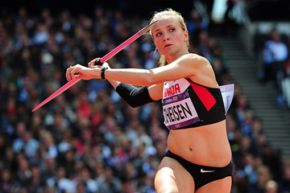
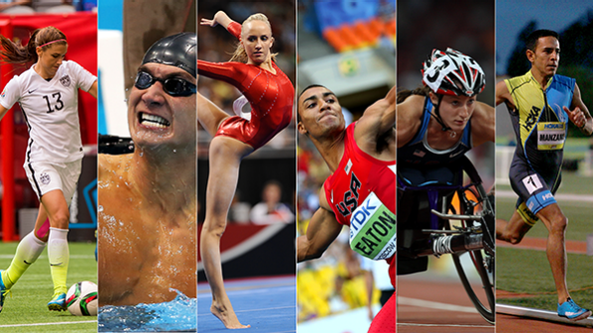
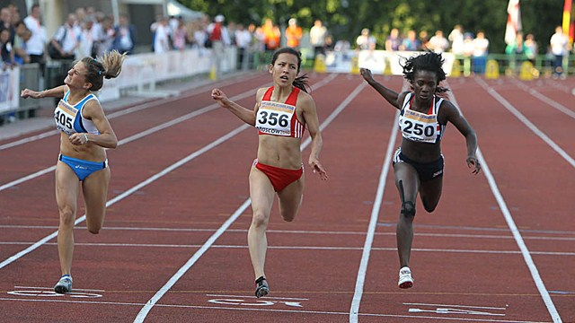
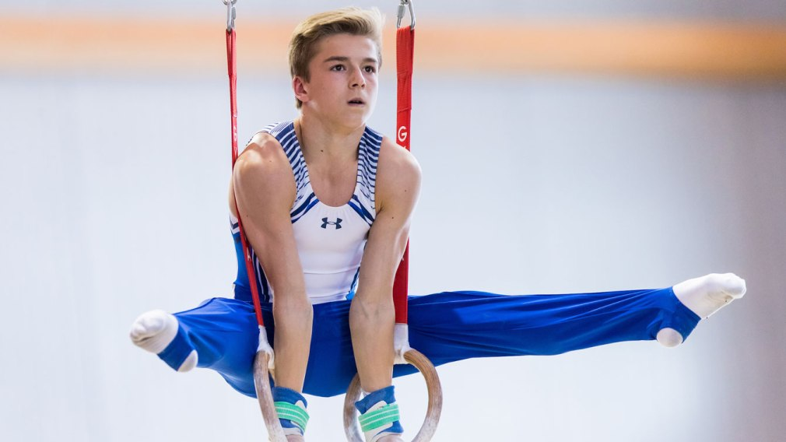
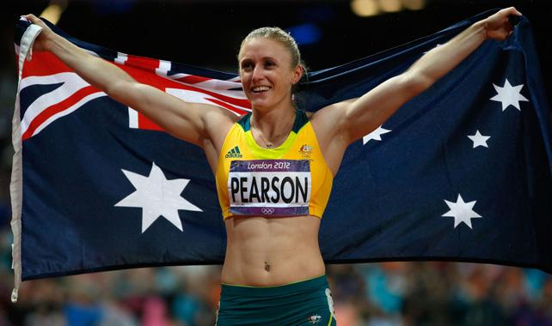

Slide 8
The Ancient Games
The Ancient Olympic Games were celebrated at Olympia, Greece every four years.
The games consisted of sports like footraces, wrestling, boxing, the pentathlon and horse racing.
When the Romans conquered Greece in 140 B.C. the games started to lose their religious meaning and in 393 the Roman emperor banned the event.

Slide 9
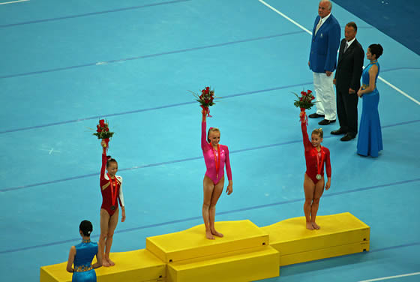
The Summer and Winter games
The Summer Games are held during the summer season of the host country.
They last for 16 days.
The first separate Winter Games were held in Chamonix, France in 1924.
They usually take place in February.

Slide 10
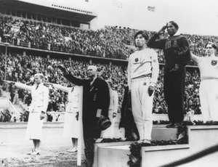
Politics and the Olympic games
In the past, the Olympic Games have been disturbed by political issues.
In 1936 the IOC chose Berlin as the site for the 1936 Summer Games.
In 1968 two Black American runners protested against their government and raised their fists when the American national anthem was played.

Slide 11
In 1980 the USA—and many other countries—didn’t send athletes to the games in Moscow because the Soviet Union had invaded Afghanistan a year before.
The worst day in Olympic history came on September 5th, 1972 during the Munich games. Eight Palestinian terrorists broke into the Olympic village and killed two Israeli athletes. 9 others were taken hostage. They wanted the Israeli government to set free over 400 Arab prisoners in Israel.

Slide 12
Olympia Today
The Olympic Games have become very successful over the past years. More and more people are able to watch them on TV and television stations are spending more money for the rights to broadcast the games.
Drugs have become a big problem.
Some athletes take drugs before and during the games in order to help their muscles grow.

Slide 13
Romania at the Olympics

Slide 14
INTRODUCTION
Romania first participated at the Olympic Games in 1900, with a single participant.
The nation first sent a team to compete at the Games in 1924, and has only missed two editions each of the Summer Olympic Games and Winter Olympic Games since then.
Notably, Romania was the lone Eastern Bloc nation to participate at the 1984 Summer Olympics.
They won 20 goldmedals and 53 medals total.

Slide 15
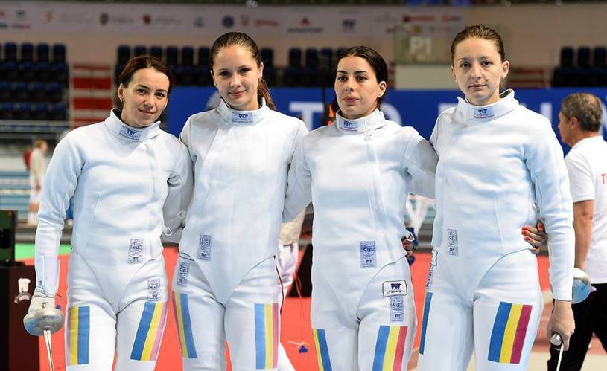
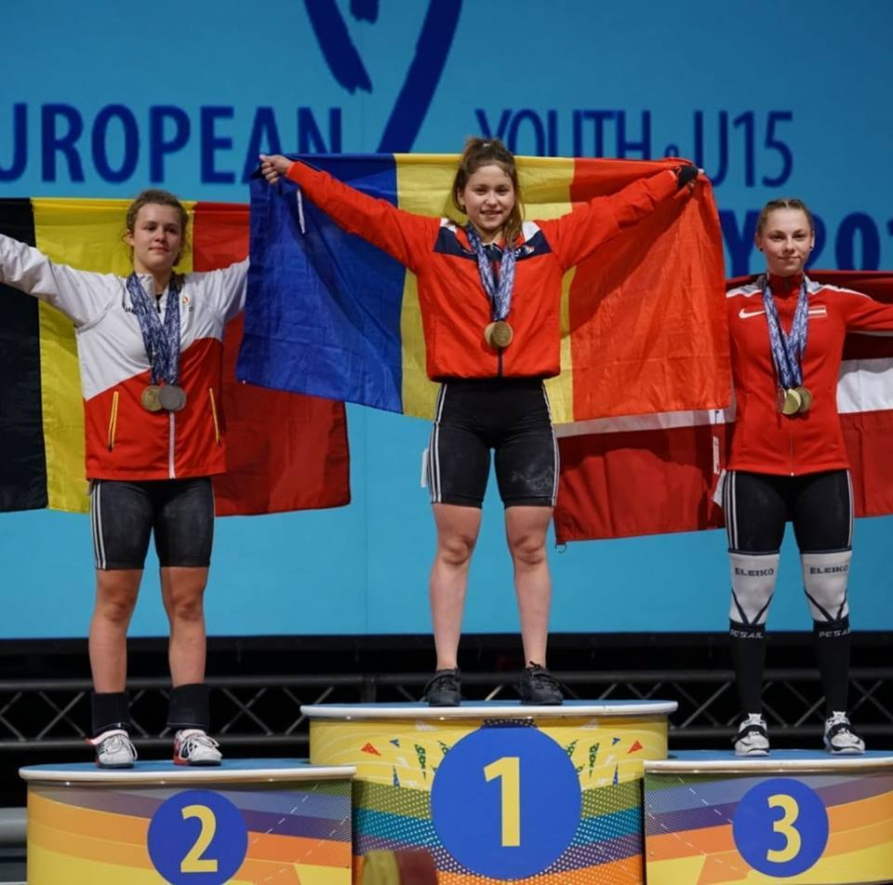
History
From the 1972 Summer Games through to the 2012 Summer Games, Romania had qualified a women's team for the gymnastics team all-around.
They had won medals at every Olympics from the 1976 Summer Games through to the 2012 Summer Games.
However the women's team failed to qualify for the 2016 Summer Games, ending the 40-year run in medals, and the 44-year run of having a team at the Olympics.

Slide 16
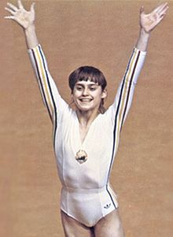
Medals so far won by Romania
Gold | Silver | Bronze | Total
89 | 95 | 123 | 307

Slide 17
Thank you for your attention!!

