Slide 1
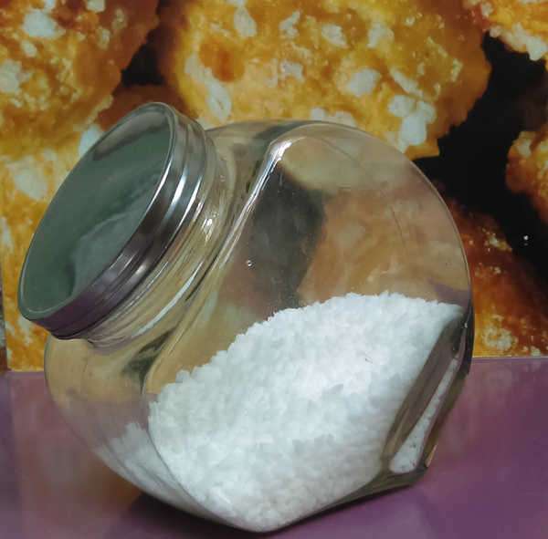
SUGARS
FRANCE

Slide 2
1- Sugars molecules

Slide 3
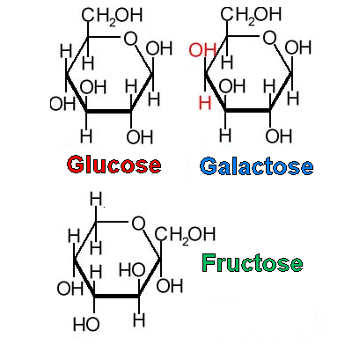
The different types of sugars :
N°1 – Monosaccharides :
the simplest forms of sugars.
C₆H₁₂O₆

Slide 4
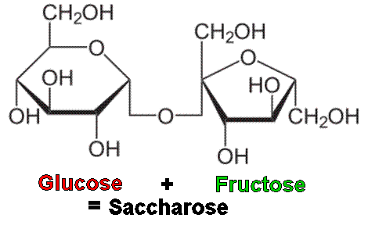
N°2 – Disaccharides :
composed of two monosaccharides.
lactose (galactose+glucose) in milk.
saccharose (glucose+fructose) in sugar beet
…..
Sugar = saccharose molecule

Slide 5
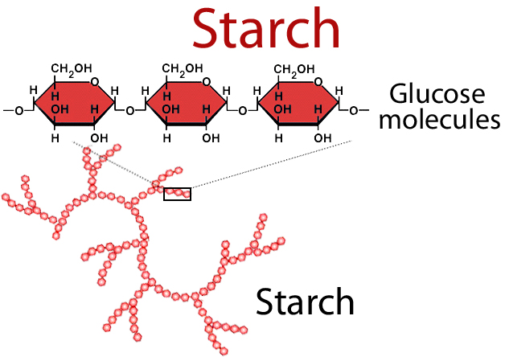
N°3 – Polysaccharides :
very long chains of hundreds of monosaccharides units.
Ex : starch, glycogen, cellulose...

Slide 6
2- History of Sugar

Slide 7
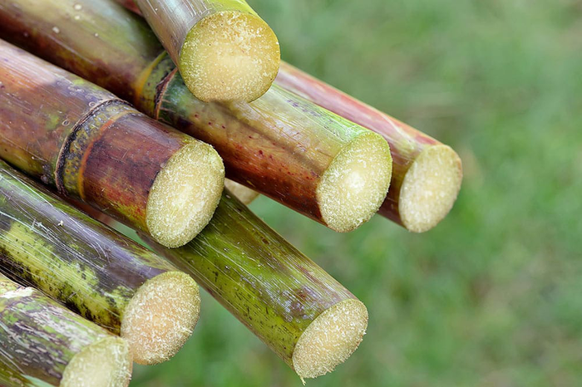
From the Orient to the Crusades
Many milleniums before J.C. : Asia

Slide 8
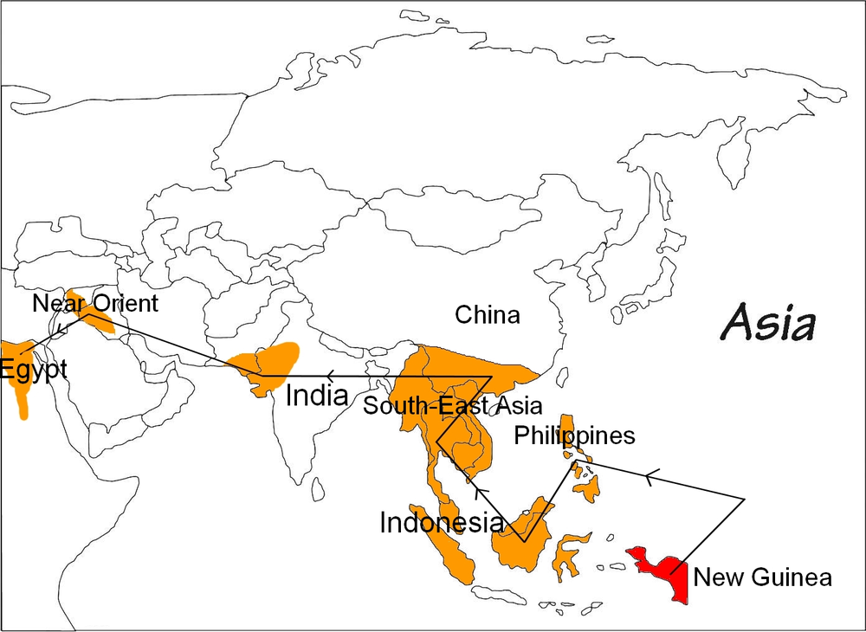

Slide 9
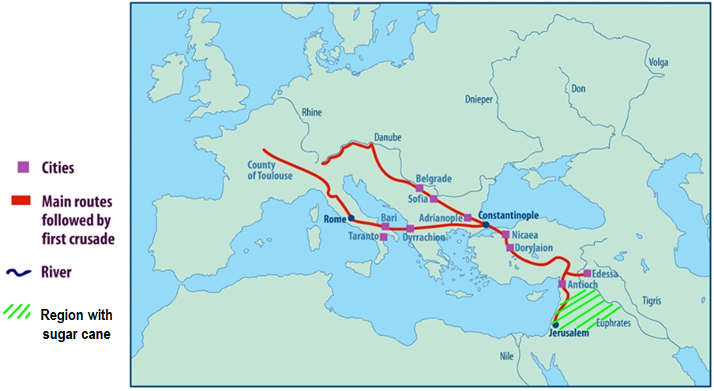
During the 12th century : sugar reached Europe.
Sugar : a rare spice !

Slide 10
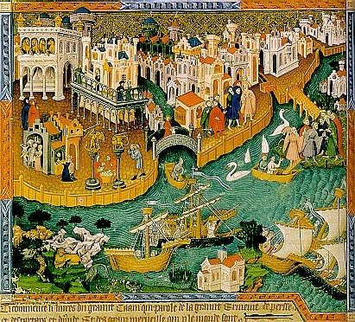
Sugar trade in Italy -Venice (the great sugar capital of Europe).

Slide 11
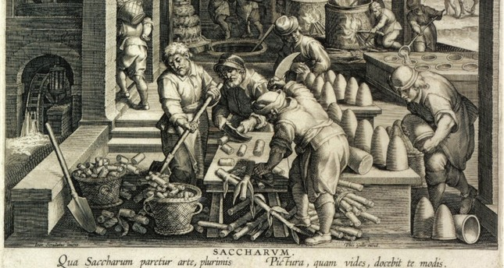
In the 14th and 15th centuries:
raw sugar in India then refined in Venice
The refining industry was born !!

Slide 12
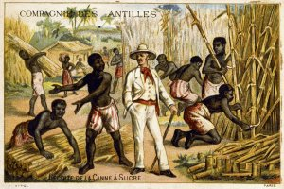
Sugar from America
During the 17th and 18th centuries, the Caribbean
is the first sugar producer of sugar cane.

Slide 13
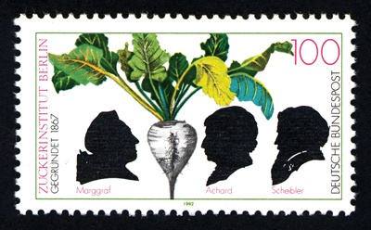
The great discovery
At the end of the 18th century, German scientists succeeded to produce sugar with beet.

Slide 14
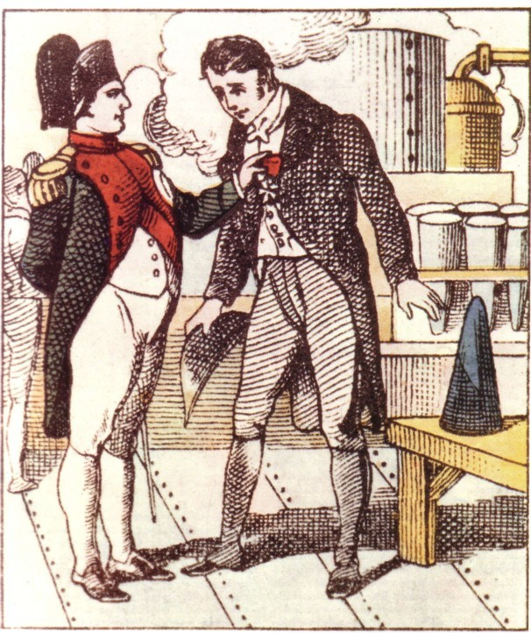
The French Empire
Napoléon the 1st encouraged the scientific research then the production of beet sugar. Sugar factories opened in the north of France.

Slide 15
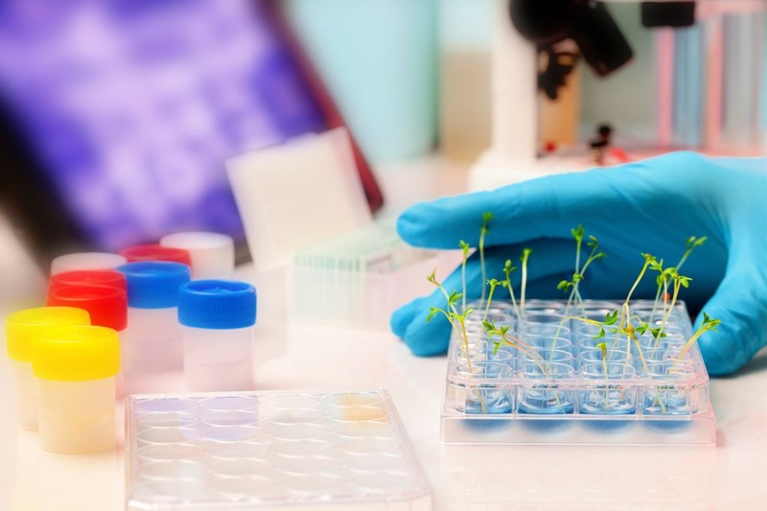
From the 19th century to nowadays
During the 20th century :
genetic and agronomic research to improve sugar yield.

Slide 16
From the 19th century to nowadays
In the 21st century:
competitiveness and ecofriendly
Sugar cane : the most common sugar in the world.
( 3/5 of the areas used for sugar production).

Slide 17
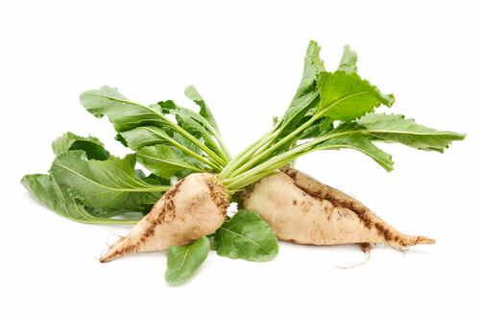
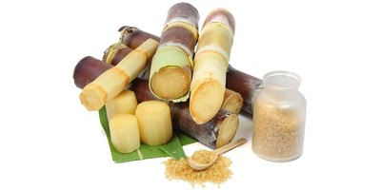
3- Photosynthesis

Slide 18
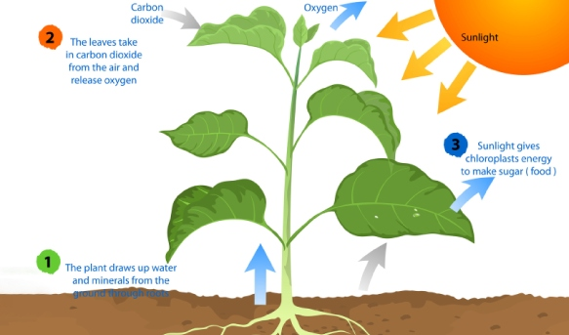
Plants need energy to live and to grow up.
To achieve photosynthesis, a plant needs carbon, hydrogen and oxygen to form glucose.

Slide 19
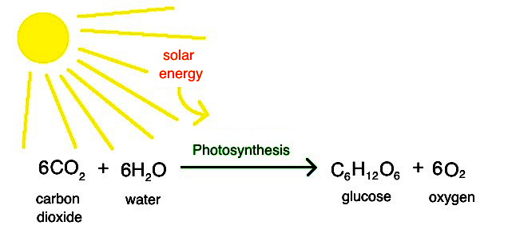
During the night : fructose is made.
During the day, in roots : glucose + fructose = saccharose

Slide 20
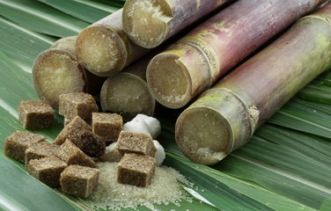
4- Sugar economy

Slide 21
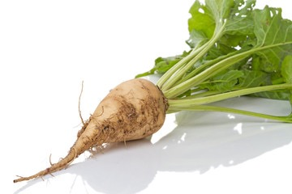
France :
- the 1st European producer of sugar
- the 1st global producer of beet sugar
- the 9th global producer of sugar
In 2017-2018 :
The sugar production: 6 million tons of beet sugar
50 % sold in France
30 % sold in the European Union
20% exported towards developing countries

Slide 22
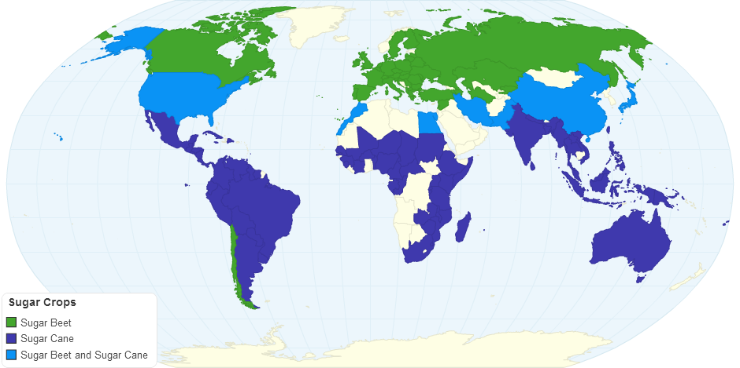
Sugar producers :

Slide 23
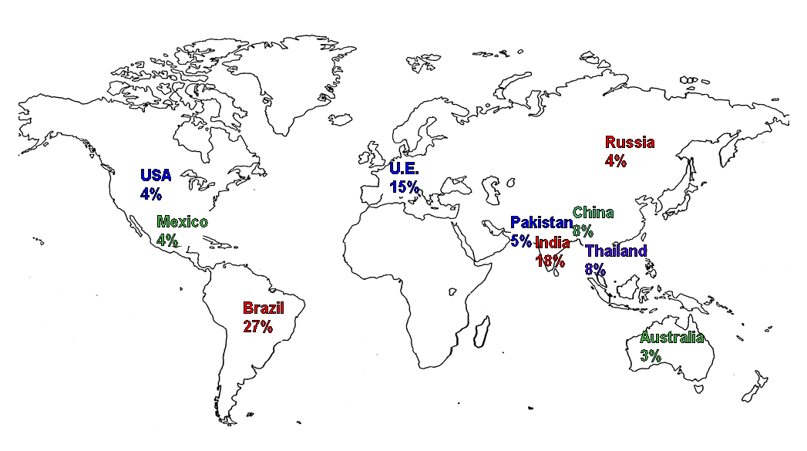
The 10 first producers:
78% of the global sugar production (140 million tons of sugar)

Slide 24
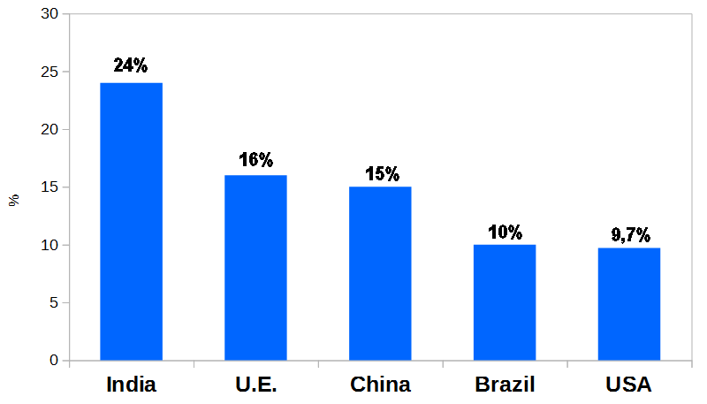
The 5 first users of sugar :

Slide 25
5- The technique to produce sugar from Sugar Beets

Slide 26
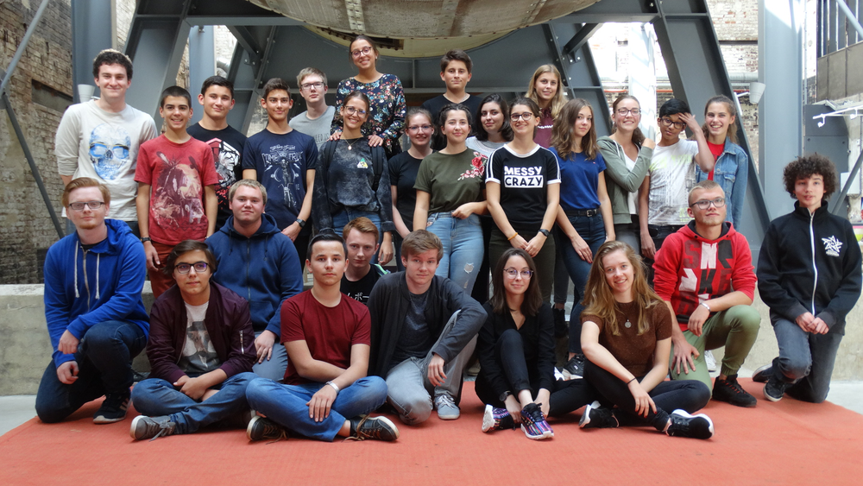

Slide 28
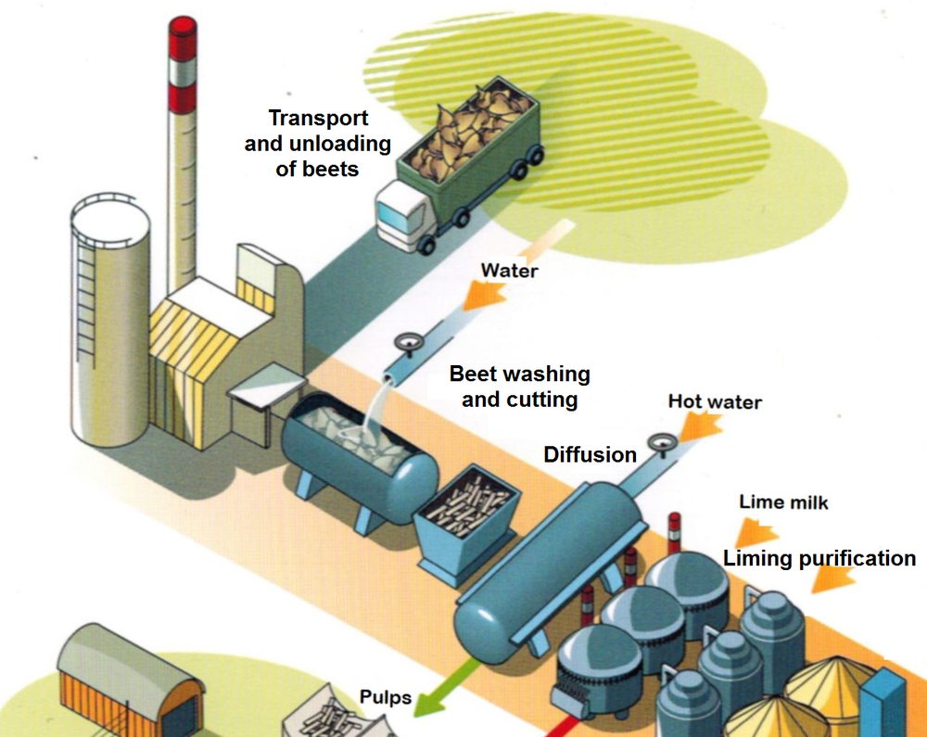

Slide 29
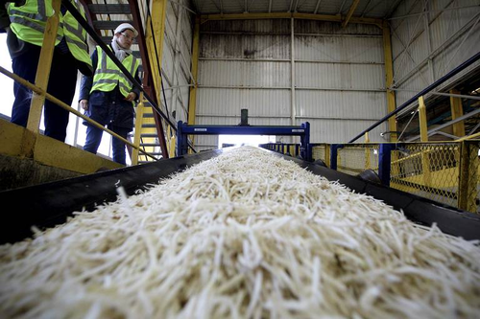
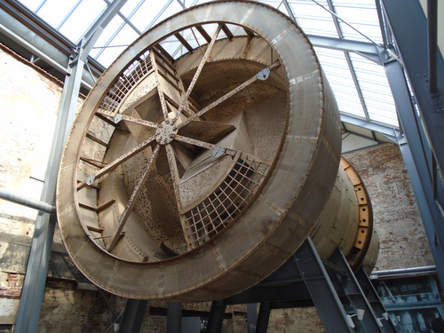
beet washing and cutting
diffusion with hot water

Slide 30
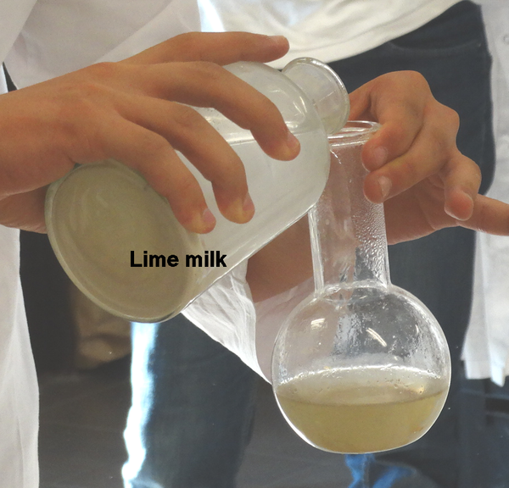
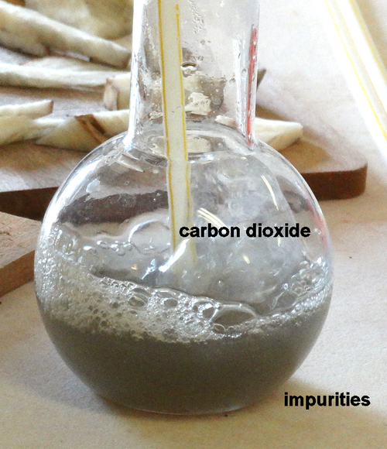
liming purification

Slide 31
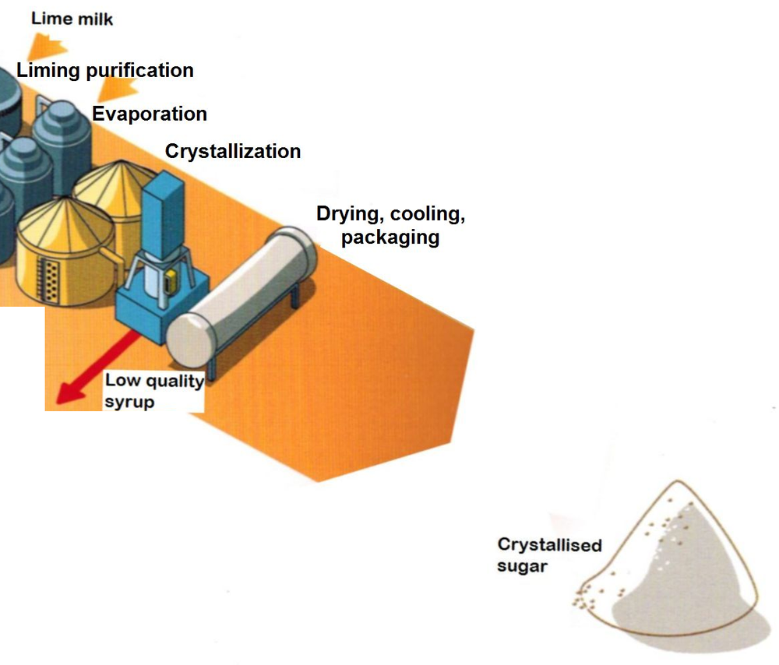

Slide 32
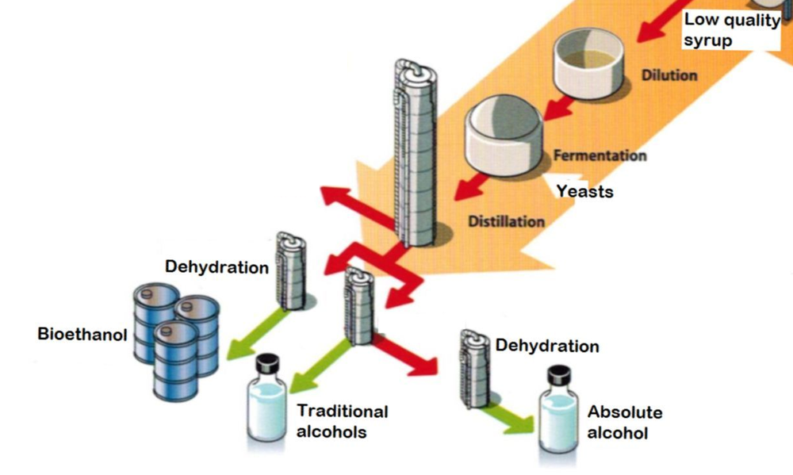

Slide 33
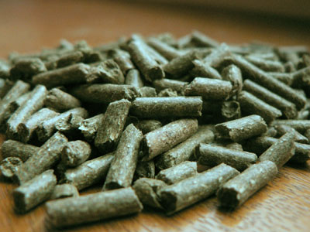
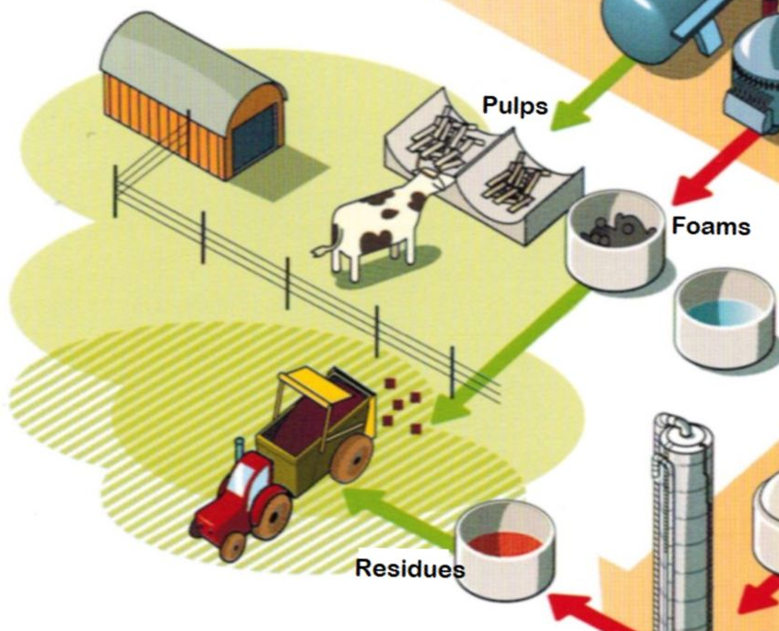

Slide 34
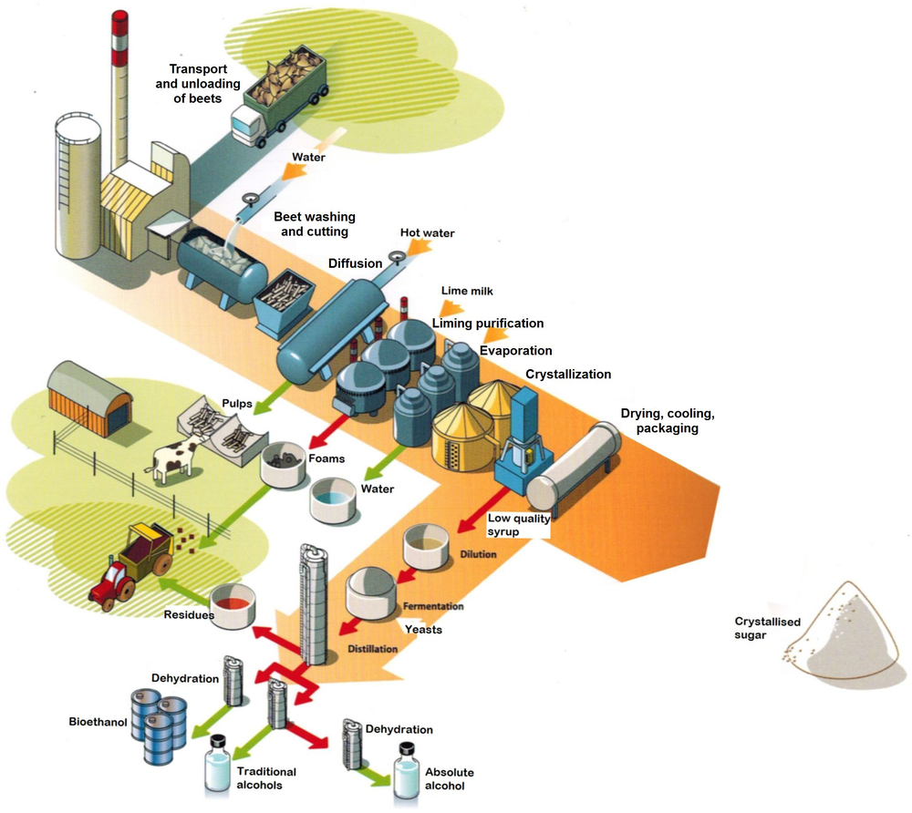

Slide 35
6-The Different
Uses Of Sugar

Slide 36
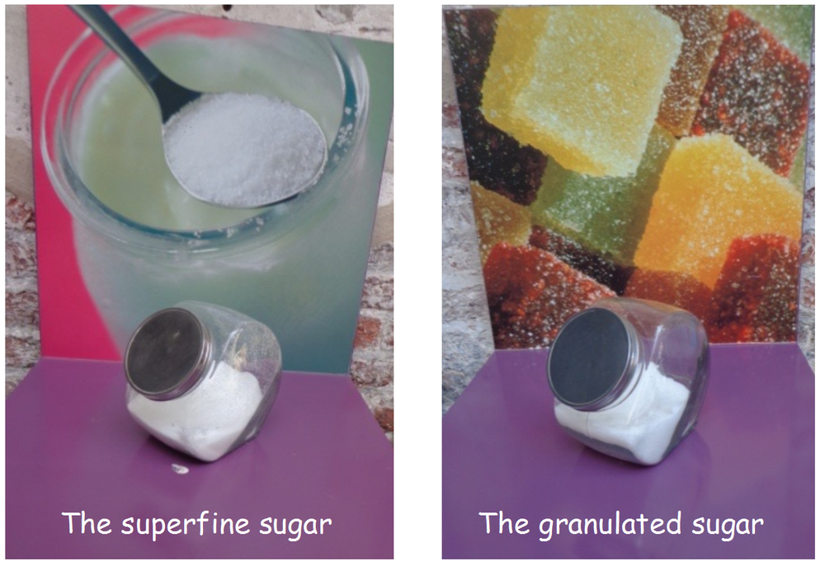
The superfine sugar
The granulated sugar

Slide 37
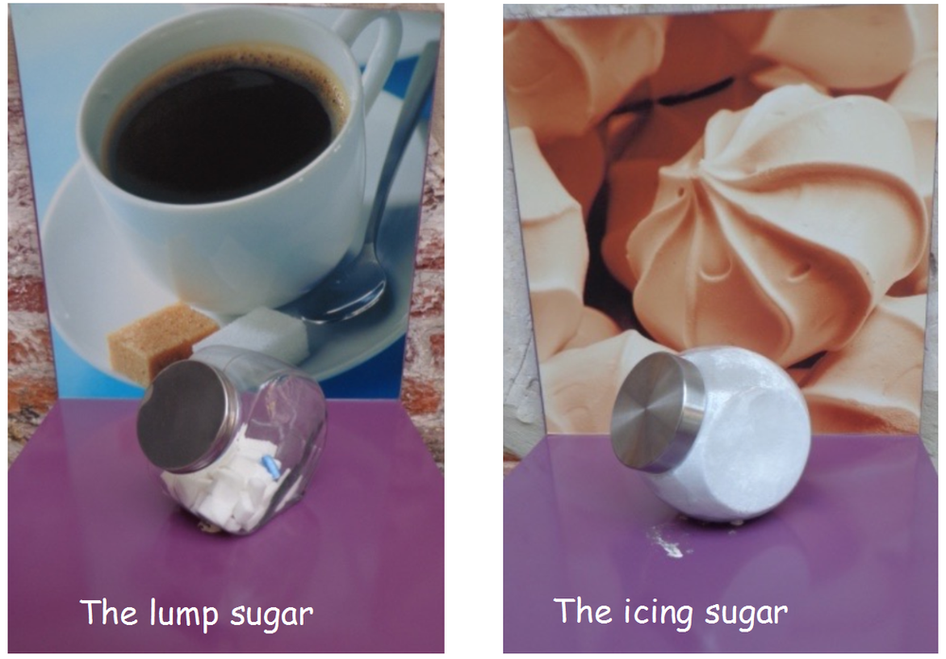
The lump sugar
The icing sugar

Slide 38
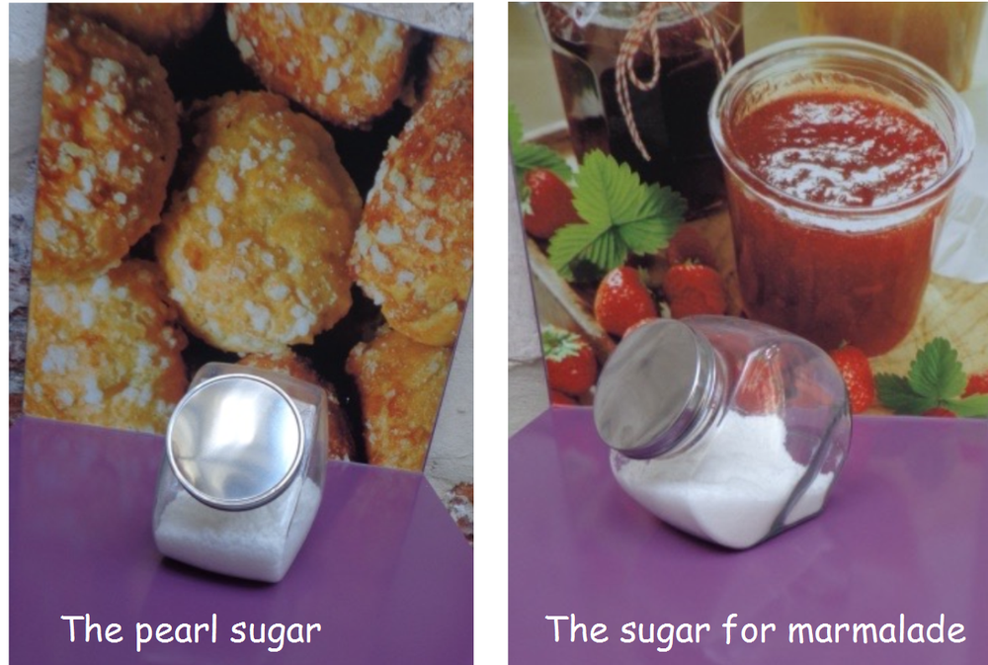
The pearl sugar
The sugar for marmalade

Slide 39
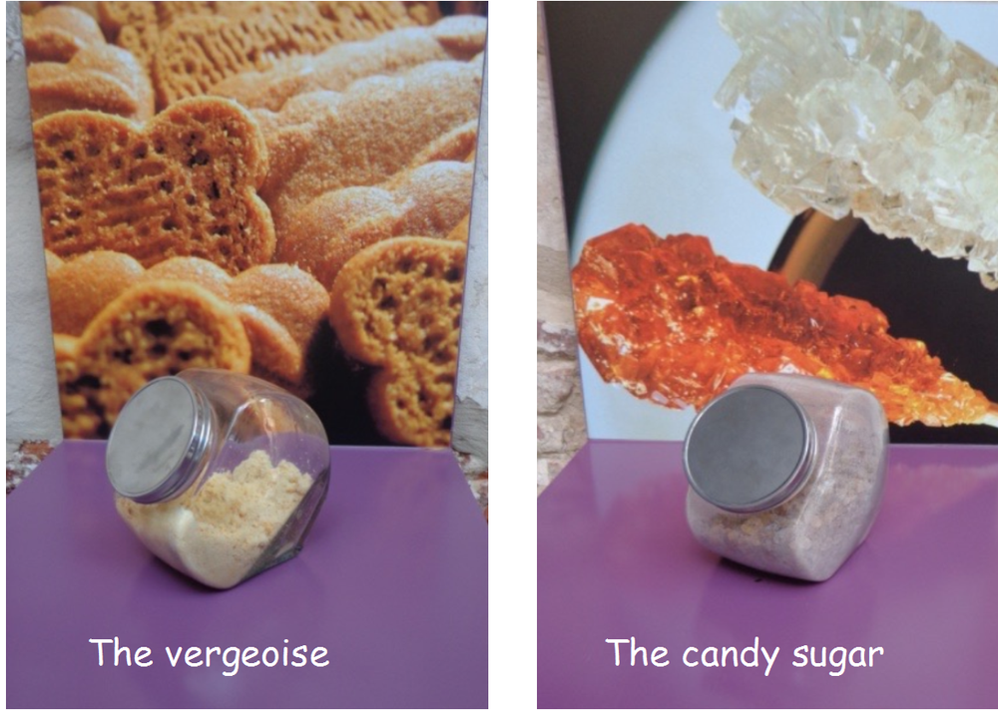
The vergeoise
The candy sugar

