Slide 1
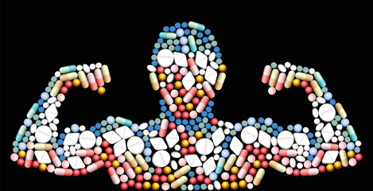
WHAT IS DOPING?
'DOPING' REFERS TO AN ATHLETE'S USE OF PROHIBITED DRUGS OR METHODS TO IMPROVE TRAINING AND SPORTING RESULTS.

Slide 2
MOST USED DRUGS AND MEDICINES
STEROIDS, STIMULANTS, HORMONES, DIURETICS, NARCOTICS, MARIJUANA, ANTINFLAMMATORY STEROIDS, ANABOLIC STEROIDS WHICH ACCELERATE MUSCLES DEVELOPMENT MEDICINES WHICH CONCEAL THE EFFECTS OF STEROIDS THE SO CALLED “ MASKING AGENTS”
FORBIDDEN METHODS (SUCH AS BLOOD TRANSFUSIONS OR GENE DOPING)
REFUSAL TO TAKE A DRUG TEST
ATTEMPT TO TAMPER WITH DOPING CONTROLS.

Slide 3
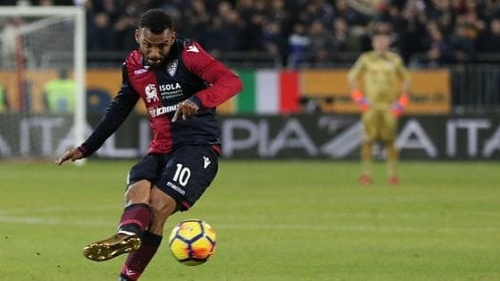
THE PROFESSIONALS ARE MONITORED BY NADO THE NATIONAL ANTI-DOPING ORGANIZATION LINKED TO WADA (WORLD ANTI DOPING ASSOCIATION)
MOST CHECKED CATEGORIES: PROFESSIONAL FOOTBALLERS AND CYCLISTS
Joao Pedro

Slide 4
RESULTS OF THE SURVEY MADE IN THE FIRST SEMESTER 2017 BY THE ITALIAN HEALTH INSTITUTE ON 429 AMATEURS
75 % OF THE CHECKED SPORT AMATEURS ADMITTED TO USE DRUGS EVEN IF THEY WERE LEGAL TO ENHANCE THEIR PERFORMANCE
35: THE AVERAGE AGE OF SPORT AMATEURS PROVED TO BE POSITIVE AT ANTI-DOPING TESTS

Slide 5
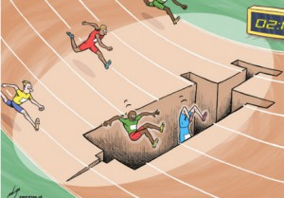
MORE DIFFICULT IS TO CHECK SPORT AMATEURS
ACCORDING TO A RECENT SURVEY OF THE ITALIAN HEALTH INSTITUTE, DOPING IS SPREADING AMONG YOUNG SPORT AMATEURS ESPECIALLY IN NEW SPORT ACTIVITIES MIXING ATHLETICS WITH BODYBUILDING (POWERLIFTING, BEACH TRAIL, CROSSFIT AND ALSO CYCLING AND RUGBY )

Slide 6
WHO MAKES MONEY ON SPORT AMATEURS?
NOT AN ORGANIZED CRIMINAL STRUCTURE
BUT
SMAL LOCAL PUSHERS
COMPLAISANT MEDICAL DOCTORS
OR
PHARMACISTS WHO SELL THESE MEDICINES UNDER THE COUNTER
IT IS ALSO POSSIBLE TO BUY THESE DRUGS ON INTERNET

Slide 7
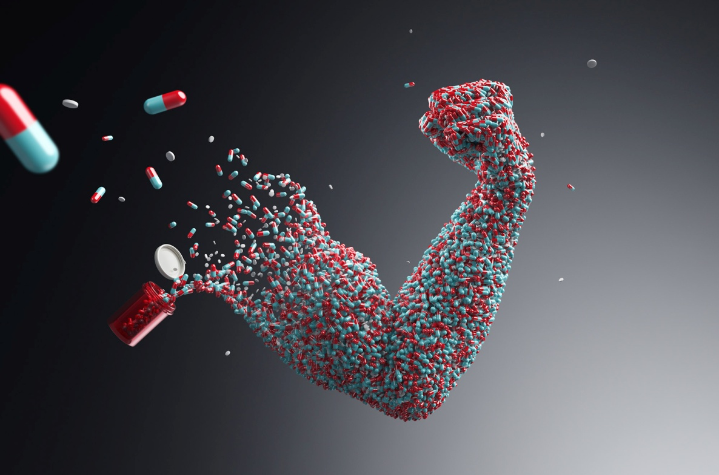
HOW CAN THIS PHENOMENON BE STOPPED ?
FIRST OF ALL DIFFERENT ATTITUDES OF PARENTS AND TRAINERS TOWARDS YOUNG AMATEURS
REDUCTION OF THE COST OF ANTIDOPING TESTS
(NOW BETWEEN €500 AND €1000 )

Slide 8
ERASMUS+KA2 MOVING2HEALTH
LICEO SCIENTIFICO GALILEO GALILEI
POTENZA - ITALY

