Slide 1
Famous Sportswomen

Slide 2
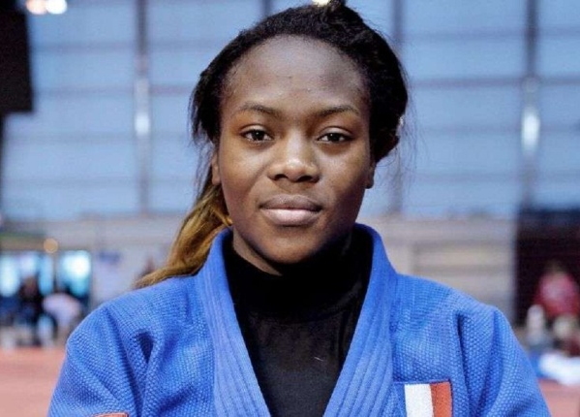
Famous Sportswomen

Slide 3
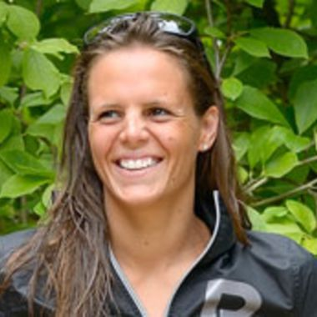
Laure Manaudou
Childhood : -Born in november 1986 -Swam for fun -Discovered by the coach Philipe Lucas
at 14 years old -Intense training in Melin

Slide 4
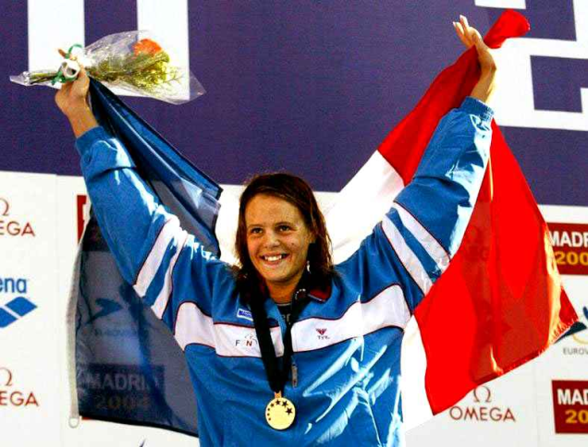
Swim Career
-In 2003 : 5 medals in France tournament -In 2004 : 3 gold medals in the Athens Olympics -In 2006 : broke the record of the 400m in free swim at the Final of the Europa Championship of swimming -in 2007 she won 5 medals: 2 gold, 2 silver and 1 bronze at the world championship in Melbourne (Australia) -In 2008 lost the Olympic games of Pekin -in 2012 eliminated from London Olympics

Slide 5
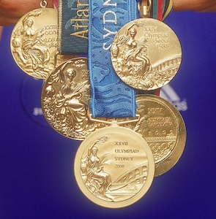
Results of her career
-127 medals with 86 gold, -5 world records -9 Europa records -41 France records

Slide 6
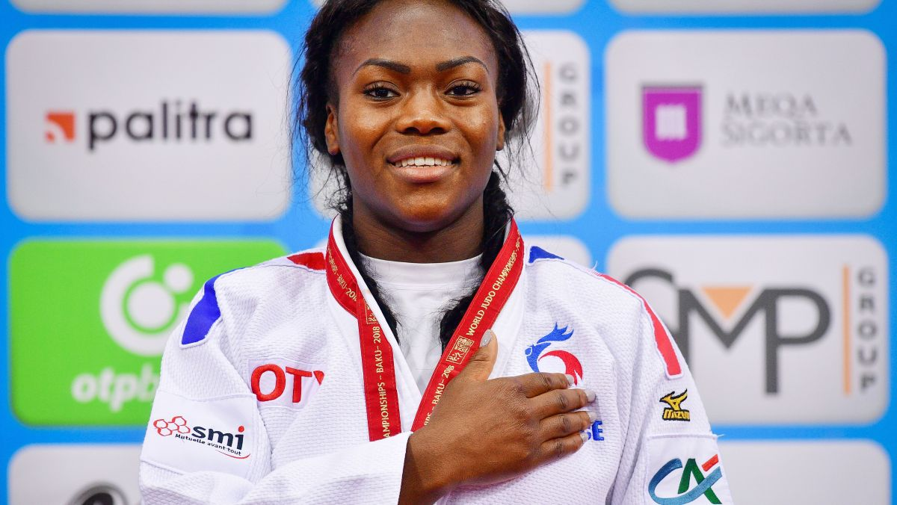
Clarisse Agbegnenou
-Born in October 1992 in France
-She started judo at 9 years old

Slide 7
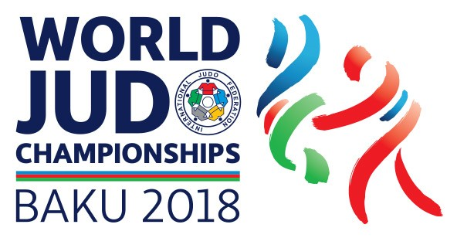
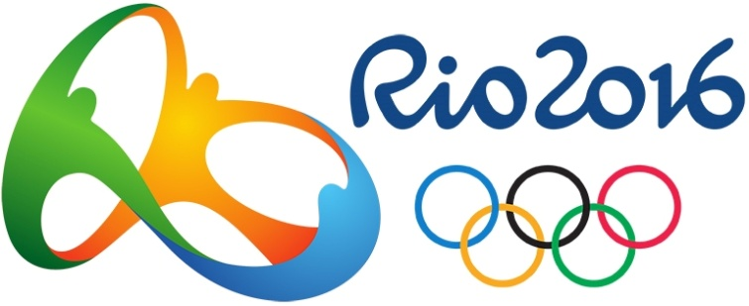
Her medals
She won the Gold Medals :
In world Championships of Chelyabinsk in 2014, Budapest in 2017 and Baku in 2018.
-In European Championships of Budapest in 2013 and of Tel Aviv in 2018.
-A silver medal at the Rio Olympics in 2016
And in French Championships in 2009, 2010 and 2012.

Slide 8
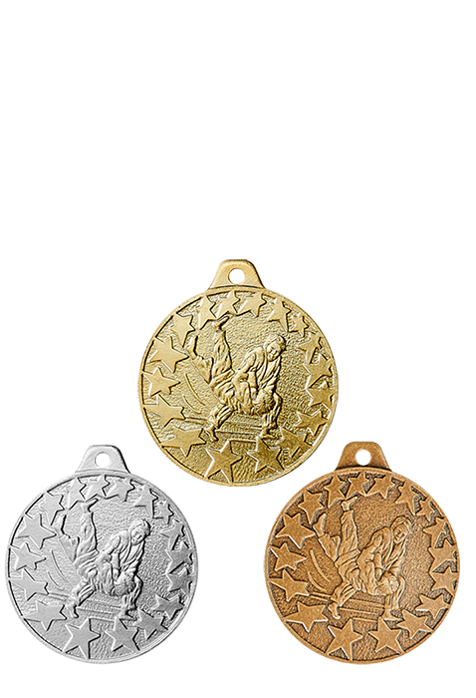
Results of her career
42 Medals:
-24 Gold Medals,
-12 Silver Medals,
-6 Bronze Medals.

