Slide 1
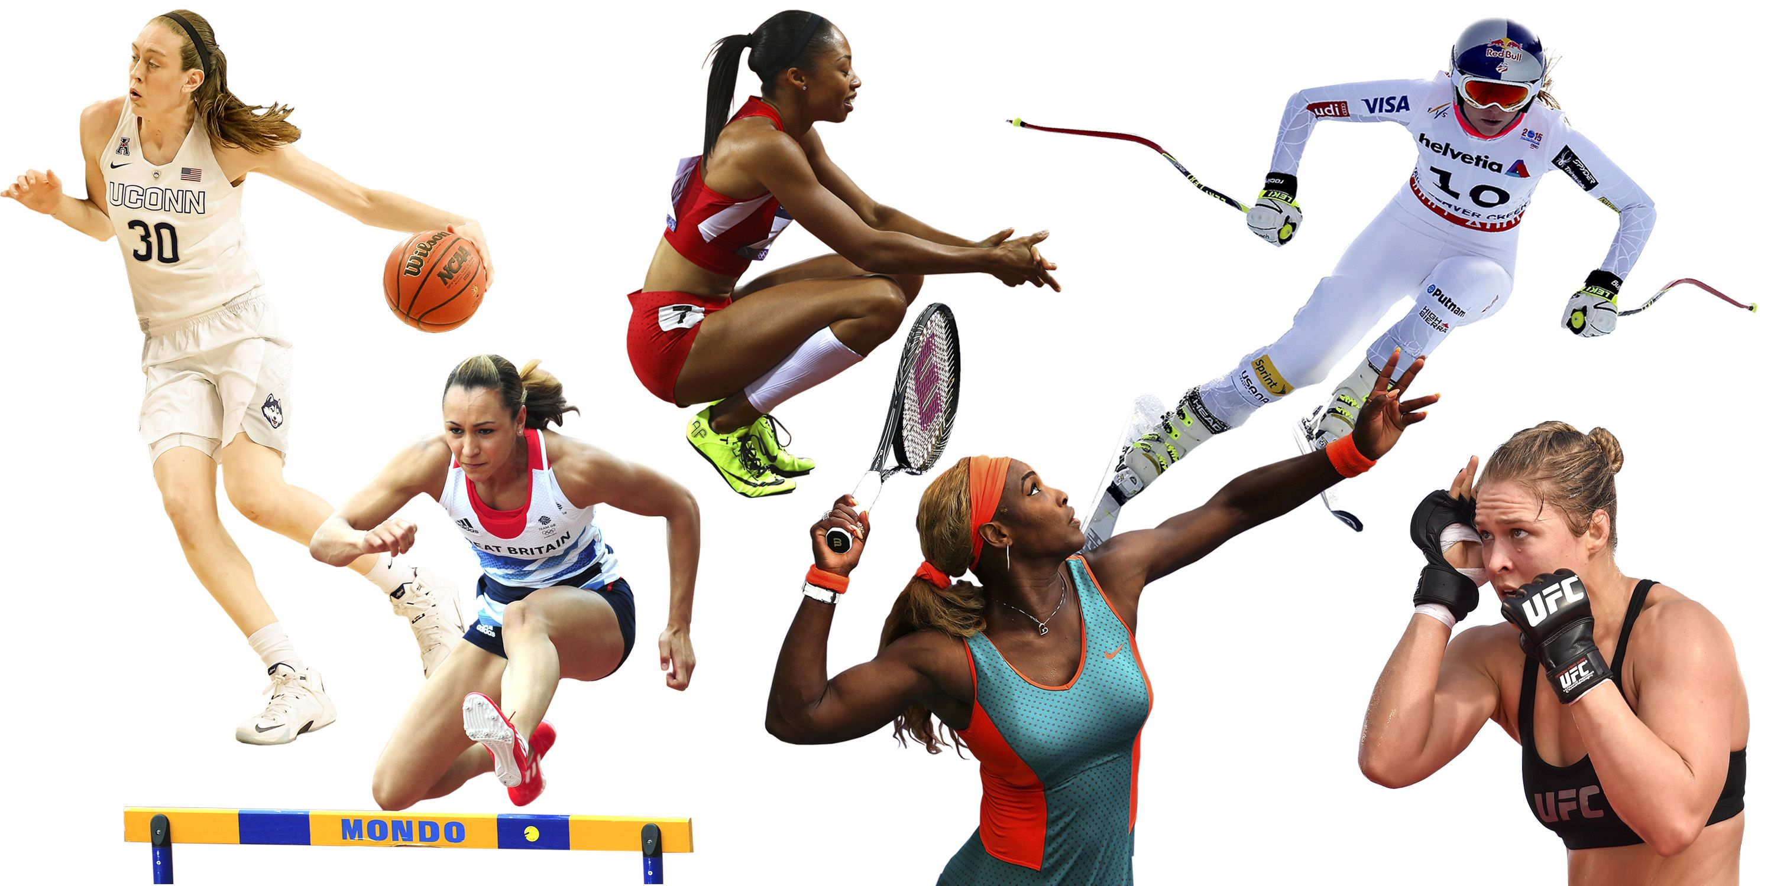
Women in sports
COLEGIUL TEHNIC LATCU VODA SIRET

Slide 2
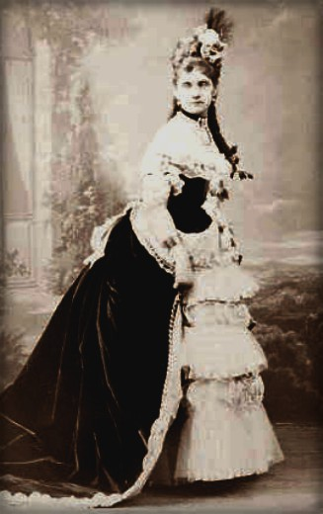
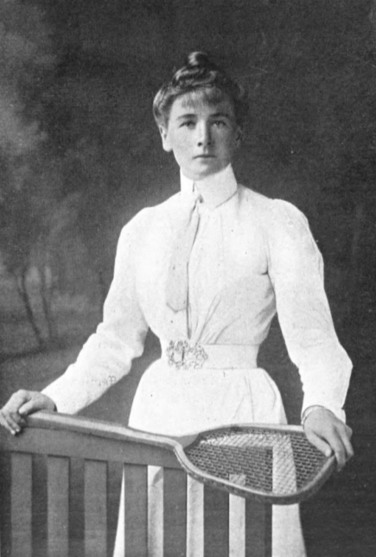
Hélène de Pourtalès of Switzerland became the first woman to compete at the Olympic Games and became the first female Olympic champion, as a member of the winning team in the first 1 to 2 ton sailing event on May 22, 1900.
Briton Charlotte Cooper became the first female individual champion by winning the women's singles tennis competition on July 11. ??????

Slide 3
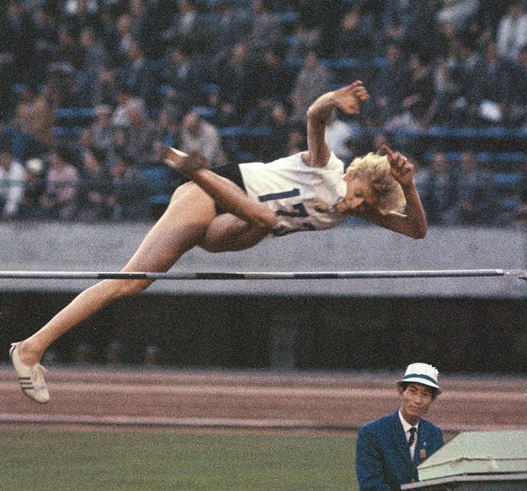
First Romanian sportswoman who won a medal at the Olympics Iolanda Balas

Slide 5
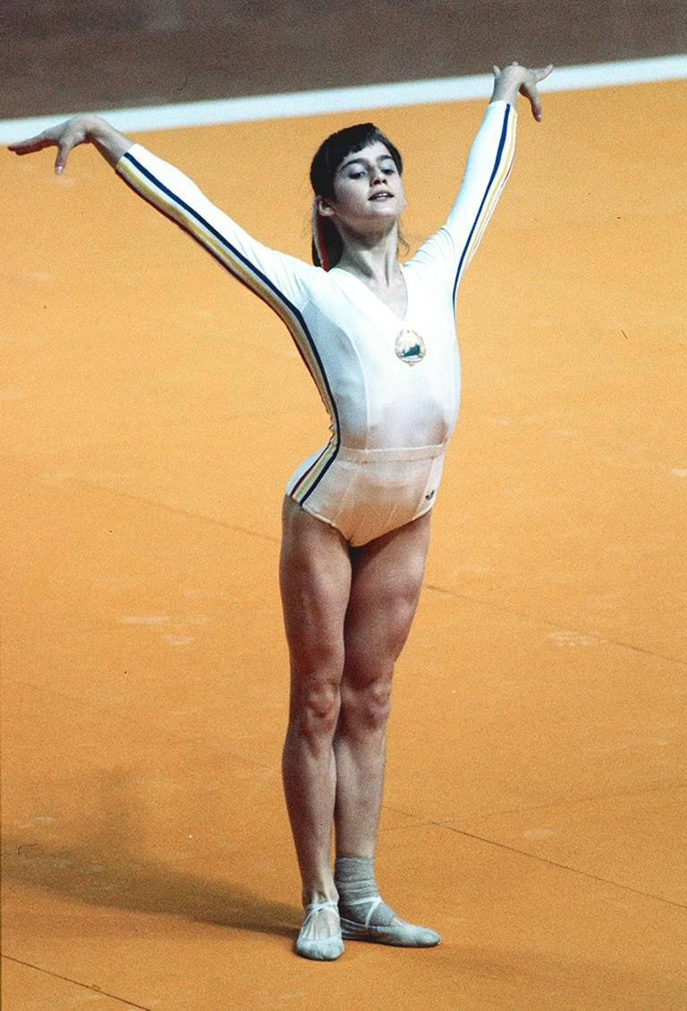
Nadia Elena Comăneci
Romanian retired gymnast and a five-time Olympic gold medalist, all in individual events.
The first gymnast to be awarded a perfect score of 10.0 at the Olympic Games, and then, at the same Games (1976 Summer Olympics in Montreal) she received six more perfect 10s en route to winning three gold medals.
At the 1980 Summer Olympics in Moscow, she won two more gold medals and attained two more perfect 10s.
One of the world's best-known gymnasts and is credited with popularizing the sport around the globe. In 2000, she was named as one of the Athletes of the 20th Century by the Laureus World Sports Academy.

Slide 6
Personal life
Born on 12 November 1961, in Onești, Romania
Comăneci graduated from Politehnica University of Bucharest with a degree in sports education that gave her the qualifications to coach gymnastics.
She has lived in the United States since 1989 and is married to American Olympic gold medal gymnast Bart Conner.

Slide 7
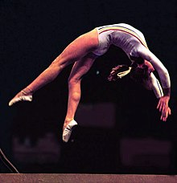
Summer Olympics in Montreal
At Montreal she received four of her seven 10s on the uneven bars. The apparatus demands such a spectacular burst of energy in such a short time—only 23 seconds—that it attracts the most fanfare. But it is on the beam that her work seems more representative of her unbelievable skill. She scored three of her seven 10s on the beam. Her hands speak there as much as her body. Her pace magnifies her balance. Her command and distance hush the crowd.
— Sports Illustrated, 1976

Slide 8
OLYMPIC GAMES
G | 1976 Montréal | All-Around
G | 1976 Montréal | Uneven Bars
G | 1976 Montréal | Balance Beam
G | 1980 Moscow | Balance Beam
G | 1980 Moscow | Floor Exercise
S | 1976 Montréal | Team
S | 1980 Moscow | Team
S | 1980 Moscow | All-Around
B | 1976 Montréal | Floor Exercise
World Championships
G | 1978 Strasbourg | Balance Beam
G | 1979 Ft. Worth | Team
S | 1978 Strasbourg | Team
S | 1978 Strasbourg | Vault

Slide 9
EUROPEAN CHAMPIONSHIP
G | 1975 Skien | All-Around
G | 1975 Skien | Uneven Bars
G | 1975 Skien | Balance Beam
G | 1975 Skien | Vault
G | 1977 Prague | All-Around
G | 1977 Prague | Uneven Bars
G | 1979 Copenhagen | All-Around
G | 1979 Copenhagen | Vault
G | 1979 Copenhagen | Floor Exercise
S | 1975 Skien | Floor Exercise
S | 1977 Prague | Vault
B | 1979 Copenhagen | Balance Beam
World Cup
G | 1979 Tokyo | Vault
G | 1979 Tokyo | Floor Exercise
S | 1979 Tokyo | Balance Beam
SUMMER UNIVERSIADE
G | 1981 Bucharest | Team
G | 1981 Bucharest | All-Around
G | 1981 Bucharest | Uneven Bars
G | 1981 Bucharest | Vault
G | 1981 Bucharest | Floor Exercise

Slide 10
Nadia Comaneci - First Perfect 10 | Montreal 1976 Olympics
Nadia Comaneci's perfect 10 | Epic Olympic Moments

Slide 11
Cristina Georgiana Neagu

Slide 12
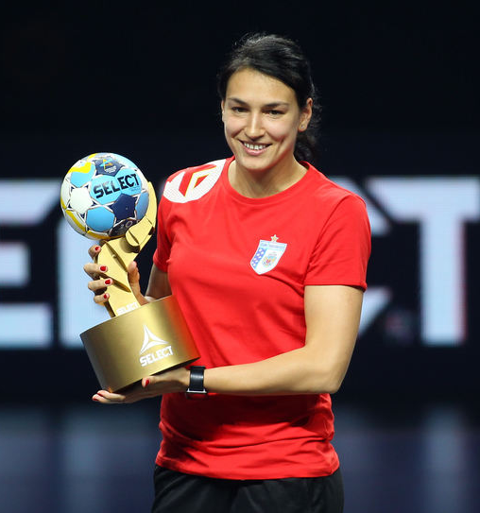
Romanian professional handballer who plays as a left back for CSM București and the Romanian national team.
Often considered the best player in the world and rated by many in the sport as the greatest handballer of all time.

Slide 13
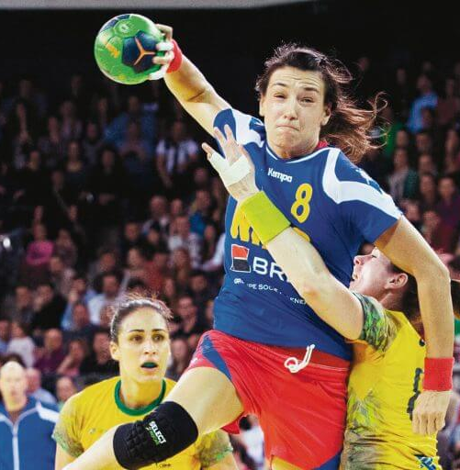
A prolific goalscorer, Neagu is the European Championship's all-time leader in goals scored (237).
In December 2015, she also received World Championship top-scorer & MVP awards. She also finished as the top scorer of the EHF Champions League in the 2014-15 and 2017-18 seasons.
She was given the award of Cetățean de onoare ("Honorary Citizen") of the city of Bucharest in 2017.

Slide 14
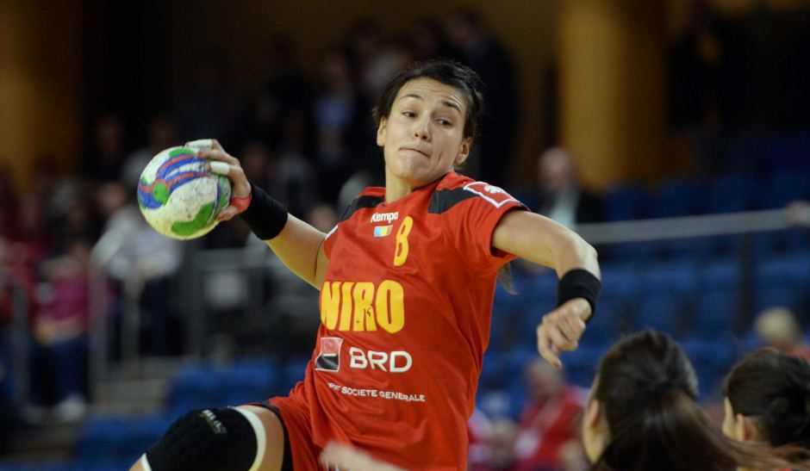
Personal life
Born in Bucharest, Romania.
Maria Covaci, local middle school coach, introduced her to handball when she was 12 years old.
Neagu is a huge football (soccer) fan and a big supporter of local team Steaua București, and attends their matches at the Arena Națională stadium.

Slide 15
Senior clubs
Years | Team
–2006 | HC Activ Ploiești
2006–2009 | CS Rulmentul Brașov
2009–2013 | CS Oltchim Râmnicu Vâlcea
2013–2017 | ŽRK Budućnost
2017– | CSM București

Slide 16
Achievements
National
Romanian National League:
Winner: 2009, 2010, 2011, 2012, 2013, 2018
Silver Medalist: 2007, 2008
Romanian Cup:
Winner: 2011, 2018
Finalist: 2007
Romanian Supercup:
Winner: 2011, 2017
Finalist: 2007, 2018
Montenegrin Championship:
Winner: 2014, 2015, 2016, 2017
Montenegrin Cup:
Winner: 2014, 2015, 2016, 2017
International
EHF Champions League:
Winner: 2015
Finalist: 2010, 2014
Third place: 2009, 2012, 2013, 2018
EHF Cup Winners' Cup:
Finalist: 2008
World Championship:
Bronze Medalist: 2015
European Championship:
Bronze Medalist: 2010
World Youth Championship:
Bronze Medalist: 2006
European Youth Championship:
Silver Medalist: 2005
European Junior Championship:
Bronze Medalist: 2007

Slide 17
Individual awards and honours
IHF
3× IHF World Player of the Year: 2010, 2015, 2016
IHF World Rookie of the Year: 2009
World Championship Most Valuable Player: 2015
World Championship Top Scorer: 2015
World Championship All-Star Team Left Back: 2015
World Youth Championship Most Valuable Player: 2006
EHF
2× EHF Player of the Year: 2017, 2018
European Championship All-Time Top Scorer (237 goals)
European Championship Top Scorer: 2010
European Championship Most Assists: 2010
3× European Championship All-Star Team Left Back: 2010, 2014, 2016
European Youth Championship Most Valuable Player: 2005
European Junior Championship All-Star Team Left Back: 2007[
2× Champions League Top Scorer: 2015, 2018
4× Champions League All-Star Team Left Back: 2015, 2016, 2017, 2018
National
6× Romanian Player of the Year: 2009, 2010, 2015, 2016, 2017, 2018
Romanian Sportsperson of the Year: 2015
Brașov County Sportsperson of the Year: 2008
2× Liga Națională Best Romanian Player: 2017, 2018
Cupa României Final Four Most Valuable Player: 2018
Prosport Most Valuable Player of the Liga Națională: 2018
Prosport All-Star Team Left Back of the Liga Națională: 2018
Other
3× Handball-Planet World Player of the Year: 2015, 2016, 2018
5× Handball-Planet All-Star Team Left Back: 2014, 2015, 2016, 2017, 2018
TV 2 Norway World Player of the Year: 2018
TV 2 Norway All-Star Team Left Back: 2018
TV 2 Norway All-Star Team Left Back of the European Championship: 2018
2× World Cup Most Valuable Player: 2009, 2010
2× Carpathian Trophy Most Valuable Player: 2017, 2018
2× Carpathian Trophy Top Scorer: 2006, 2015
2× Bucharest Trophy All-Star Team Left Back: 2014, 2015

Slide 18
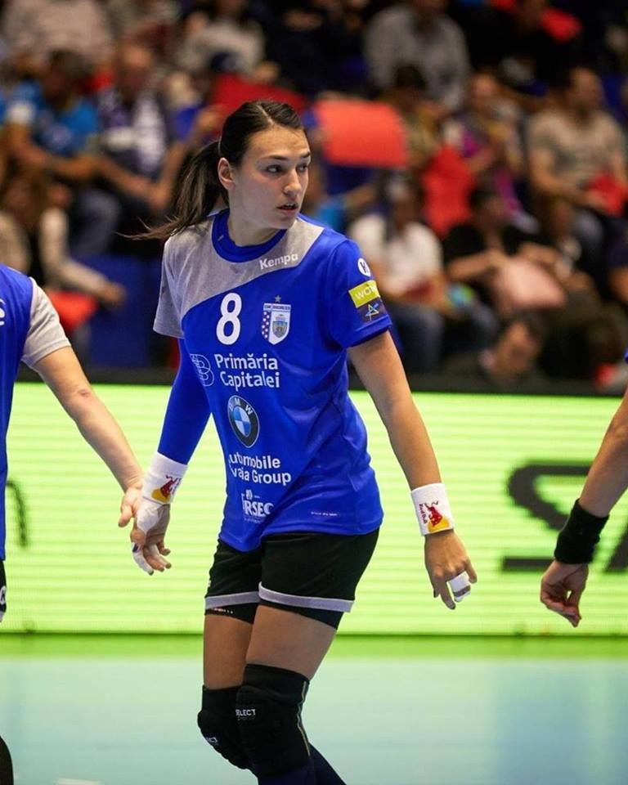
Cristina Neagu - Can't be touched
Cristina Neagu The Best Woman Handball Player 2015

Slide 19
