Slide 1
ADDICTION TO MEDICINES
ERASMUS+KA2 MOVING2HEALTH
Liceo Scientifico G.Galilei
Potenza –Italy

Slide 2
OXYCODONE
HYDROCODONE

Slide 3
OXYCODONE AND HYDROCODONE ARE OPIOID ANALGESICS THAT ARE MOST OFTEN PRESCRIBED TO CONTROL SEVERE PAIN THAT CANNOT BE TREATED WITH OTHER MEDICATIONS.

Slide 4
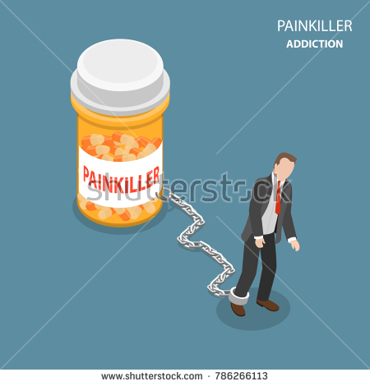
UNFORTUNATELY BOTH DRUGS HAVE A SIGNIFICANT POTENTIAL FOR ABUSE AND ADDICTION. LIKE ALL OPIATES, THEY WORK BY BINDING TO OPIOID RECEPTORS IN THE BRAIN AND SPINAL CORD.
THESE RECEPTORS ARE RESPONSIBLE FOR THE PAIN-RELIEVING EFFECTS THAT PATIENTS NEED AT HIGHER DOSES, AS WELL AS THE EUPHORIC EFFECTS THAT ABUSERS SEEK.
SOME PEOPLE TAKE THESE “PAINKILLERS” WITHOUT PRESCRIPTION, OR TAKE MORE THAN WHAT IS PRESCRIBED BY THEIR DOCTORS, RISKING TO DEVELOP ADDICTION

Slide 5
THE GROWTH OF LEGAL PRESCRIPTION OF THESE TWO DRUGS HAS INCREASED THEIR AVAILABILITY IN THE US AND A GREATER AMOUNT OF THESE DRUGS IS NOW BEING DIVERTED TO STREET USERS.
MAJOR SOURCES OF “PAINKILLERS” ON SALE ON THE BLACK MARKET INCLUDE:
FORGED PRESCRIPTIONS
PHARMACY BREAK-INS AND ROBBERIES
DIVERSION BY UNETHICAL DOCTORS

Slide 6
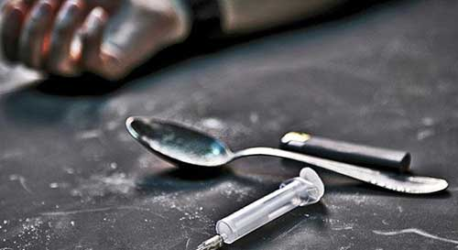
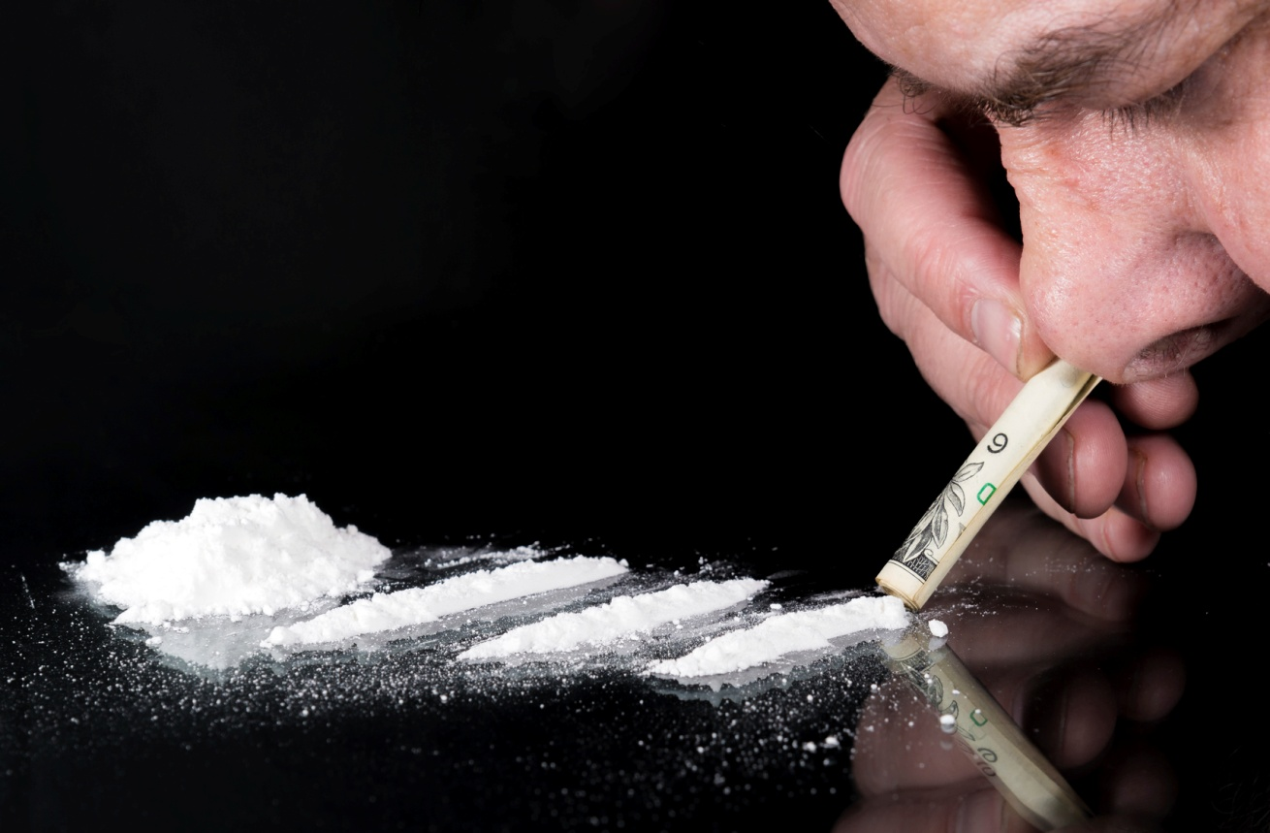
THOSE ABUSING THESE DRUGS MAY CRUSH UP THEIR PILLS AND SNORT OR INJECT THE CONTENTS.
IN 2014 LAWMAKERS RECOGNIZED THE INCREASING DANGERS OF ABUSE AND ADDICTION OF HYDROCODONE COMBINATION PRODUCTS SUCH AS VICODIN.

Slide 7
WHO KNOWS THIS MAN?
CONTINUED ABUSE OF HYDROCODONE CAN CAUSE SHORT- AND LONG –TERM DAMAGE TO THE USER’S BODY AND MENTAL STATE. MANY PEOPLE WHO ABUSE HYDROCODONE PRODUCTS LIKE VICODIN ARE LOOKING FOR A EUPHORIC STATE OR A WAY TO NUMB THEIR PHYSICAL OR PSYCHOLOGICAL PAIN.

