Slide 1
Pogoń Szczecin
Sebastian Rudol
Łukasz Zwoliński

Slide 2
Sebastian Rudol
He is 22 years old and he's a Polish football player. He plays in Polish club Pogoń Szczecin.
He was a student in our school.

Slide 3
Łukasz Zwoliński
He's 25 years old. He plays in Polish club Pogoń Szczecin.

Slide 5
5th of February, during the meeting with footballers of Pogoń Szczecin we found out about a lot of facts from their lifes.

Slide 6
Diet
Diet is very important for every sportsman.

Slide 7
Footballers eat their meals the same time everyday.
Dishes are easily digested and full of vitamins.
They have to deliver to their bodies appropriate amount of protein and carbohydrates.

Slide 8
Sportsmen have to take care about their weight because they have to pay for every extra kilogram. In that case they can't eat in fast-food restaurants like McDonald or KFC.

Slide 9
Physical activity
It's obvious that footballers have their trainings almost everyday.
They have to be perfectly prepared for every match. They train a few hours per day to reach the best scores.

Slide 12
Relax is important too. It helps to neutralise sports injuries.
Doctors and massagers care about condition of footballer's organism.

Slide 13
Drugs
Alcohol, drugs and cigarettes shouldn't be a part of a footballer's life.
Consequence of using drugs is low level of condition and productivity. Our guests are against drugs.

Slide 14
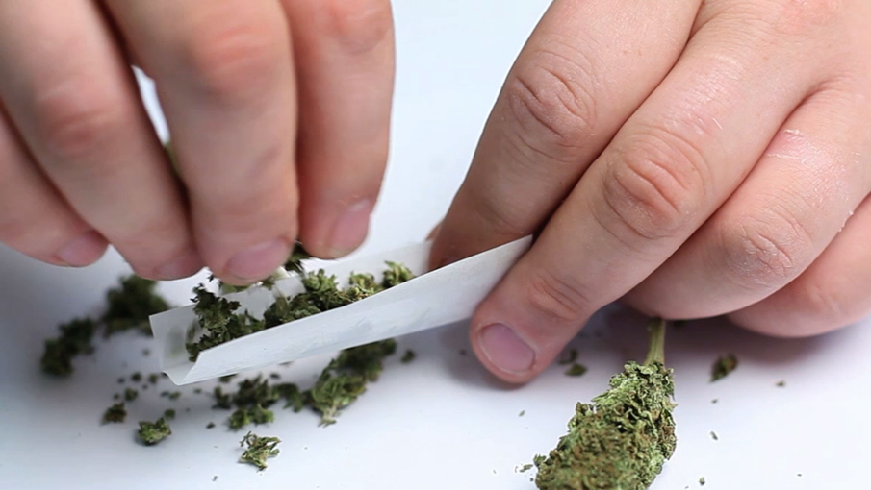
Football players are tested to see whether they have drugs in their organisms or not.
The tests aren’t usually announced before taking them.

Slide 15
Really tight schedule, planned whole day. Strict diet and challenging workouts.. all those things have a huge influence on their private lives.
Crisis and being reluctant are the things that appear really frequently but hard work and engagement guarantee the players success and victory.
Kliknij, aby dodać tekst

Slide 16
"Football is our whole world"

